Slide 1
Review of Signals and Systems
Gaurav S. Kasbekar
Dept. of Electrical Engineering
IIT Bombay

Slide 2
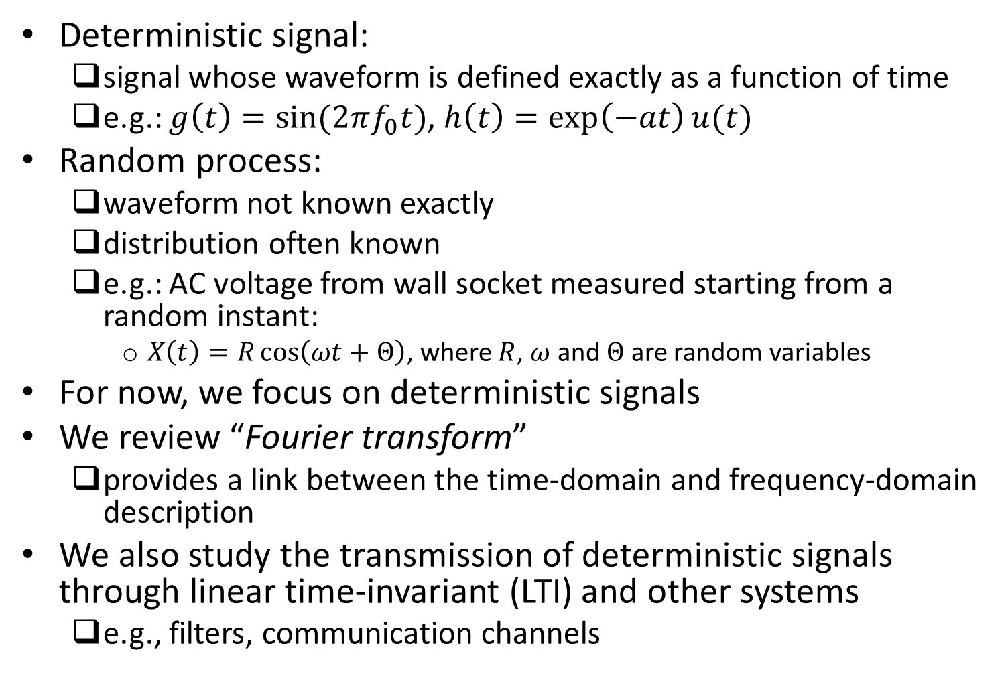
Introduction
Deterministic signal:
signal whose waveform is defined exactly as a function of time
e.g.: $g\left(t\right)=sin⁡(2πf_{0}t)$, $h\left(t\right)=\exp\left(−at\right)u(t)$
Random process:
waveform not known exactly
distribution often known
e.g.: AC voltage from wall socket measured starting from a random instant:
$X\left(t\right)=R\cos\left(ωt+Θ\right)$, where $R$, $ω$ and $Θ$ are random variables
For now, we focus on deterministic signals
We review “Fourier transform”
provides a link between the time-domain and frequency-domain description
We also study the transmission of deterministic signals through linear time-invariant (LTI) and other systems
e.g., filters, communication channels

Slide 3
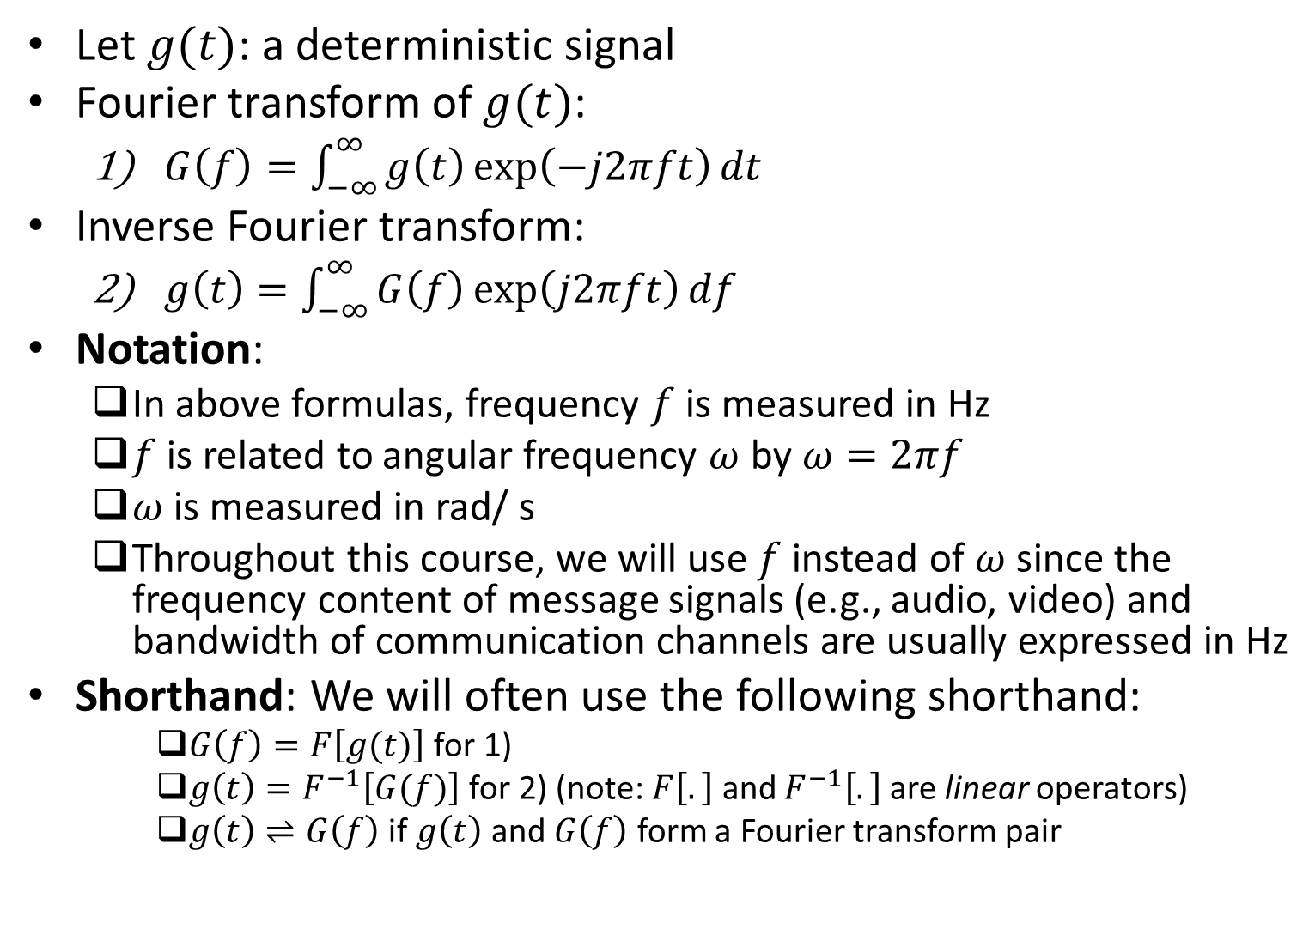
Fourier Transform
Let $g(t)$: a deterministic signal
Fourier transform of $g(t)$:
$G\left(f\right)=\int_{−∞}^{∞}{g\left(t\right)\exp\left(−j2πft\right)dt}$
Inverse Fourier transform:
$g\left(t\right)=\int_{−∞}^{∞}{G\left(f\right)\exp\left(j2πft\right)df}$
Notation:
In above formulas, frequency $f$ is measured in Hz
$f$ is related to angular frequency $ω$ by $ω=2πf$
$ω$ is measured in rad/ s
Throughout this course, we will use $f$ instead of $ω$ since the frequency content of message signals (e.g., audio, video) and bandwidth of communication channels are usually expressed in Hz
Shorthand: We will often use the following shorthand:
$G\left(f\right)=F\left[g(t)\right]$ for 1)
$g\left(t\right)=F^{−1}\left[G(f)\right]$ for 2) (note: $F\left[.\right]$ and $F^{−1}\left[.\right]$ are linear operators)
$g\left(t\right)⇌G\left(f\right)$ if $g\left(t\right)$ and $G\left(f\right)$ form a Fourier transform pair

Slide 4
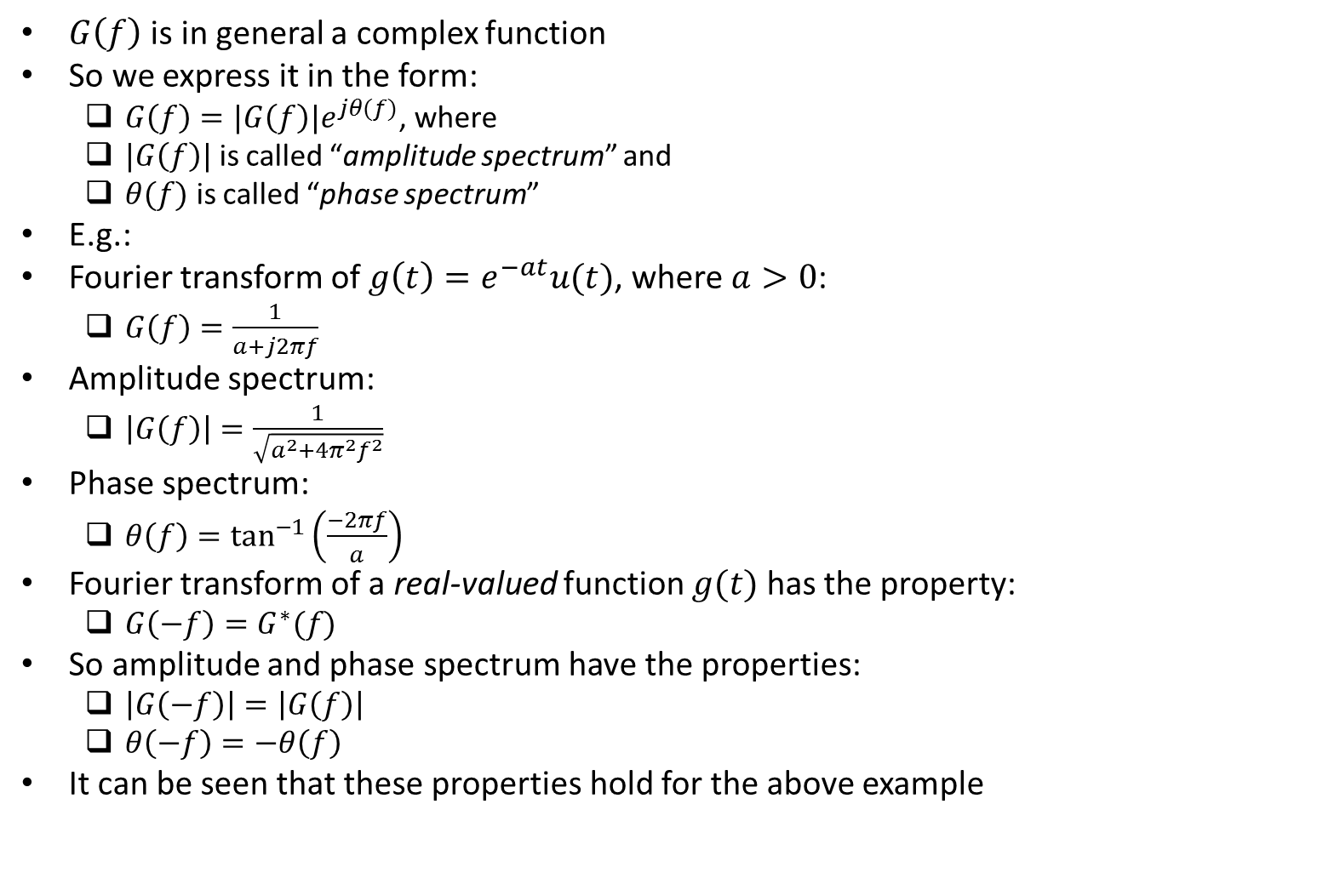
Amplitude and Phase Spectrum
$G\left(f\right)$ is in general a complex function
So we express it in the form:
$G\left(f\right)=|G\left(f\right)|e^{jθ(f)}$, where
$|G\left(f\right)|$ is called “amplitude spectrum” and
$θ(f)$ is called “phase spectrum”
E.g.:
Fourier transform of $g\left(t\right)=e^{−at}u(t)$, where $a>0$:
$G\left(f\right)=\frac{1}{a+j2πf}$
Amplitude spectrum:
$\left|G\left(f\right)\right|=\frac{1}{\sqrt{a^{2}+4π^{2}f^{2}}}$
Phase spectrum:
$θ\left(f\right)=\tan^{−1}\left(\frac{−2πf}{a}\right)$
Fourier transform of a real-valued function $g(t)$ has the property:
$G\left(−f\right)=G^{∗}(f)$
So amplitude and phase spectrum have the properties:
$\left|G\left(−f\right)\right|=\left|G\left(f\right)\right|$
$θ\left(−f\right)=−θ\left(f\right)$
It can be seen that these properties hold for the above example

Slide 5
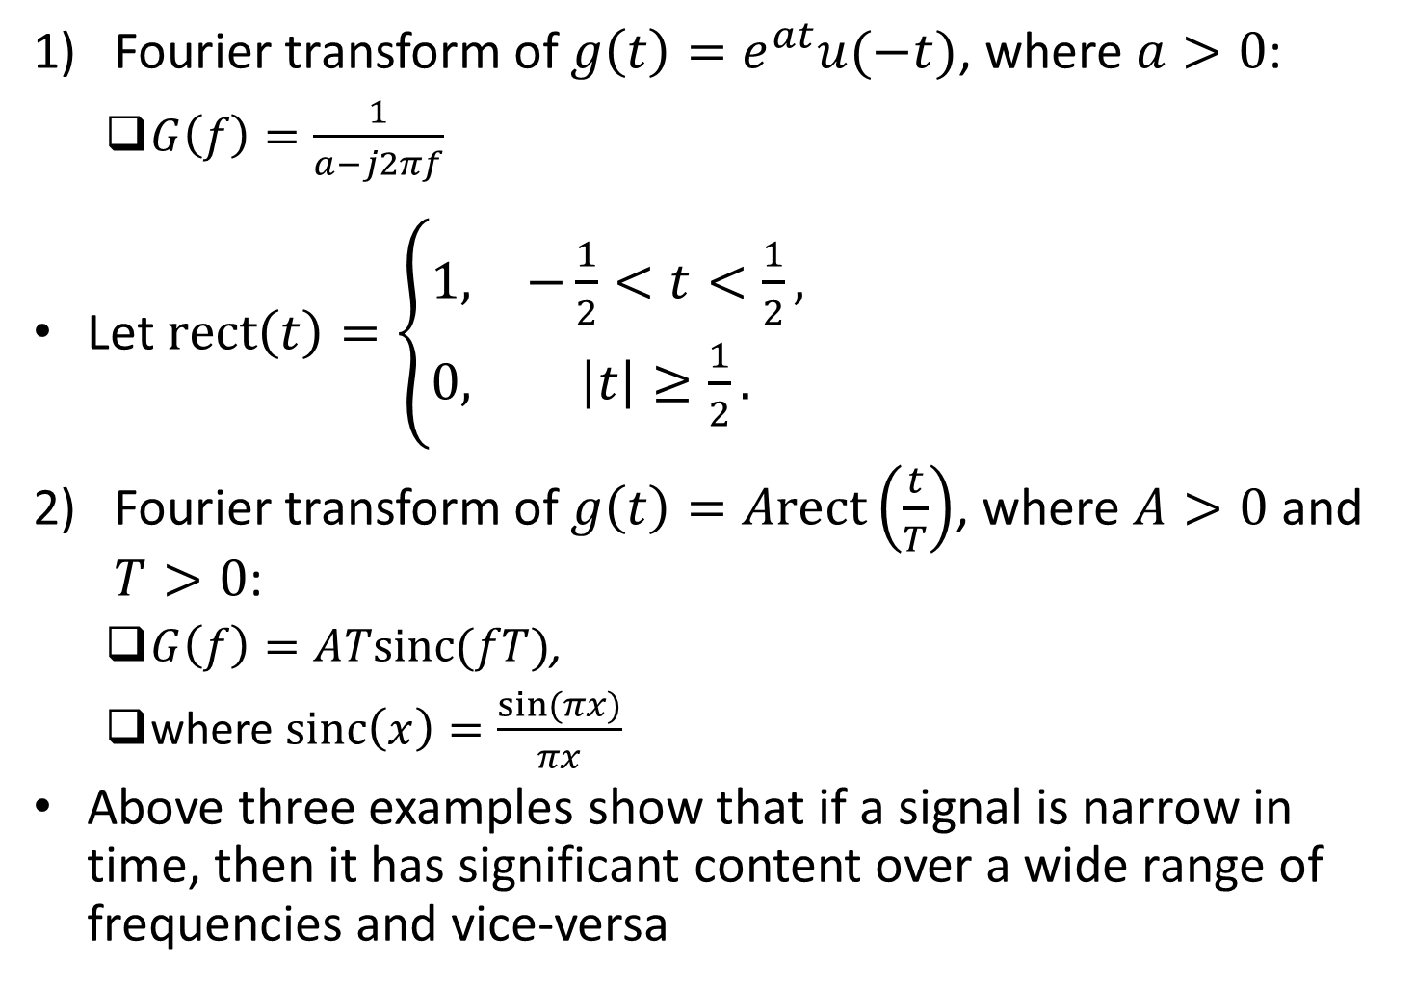
Examples
Fourier transform of $g\left(t\right)=e^{at}u(−t)$, where $a>0$:
$G\left(f\right)=\frac{1}{a−j2πf}$
Let $rect\left(t\right)=\left\{\begin{matrix}1, & −\frac{1}{2}<t<\frac{1}{2}, \\ 0, & \left|t\right|≥\frac{1}{2}.\end{matrix}\right.$
Fourier transform of $g\left(t\right)=Arect\left(\frac{t}{T}\right)$, where $A>0$ and $T>0$:
$G\left(f\right)=ATsinc(fT)$,
where $sinc\left(x\right)=\frac{sin⁡(πx)}{πx}$
Above three examples show that if a signal is narrow in time, then it has significant content over a wide range of frequencies and vice-versa

Slide 6
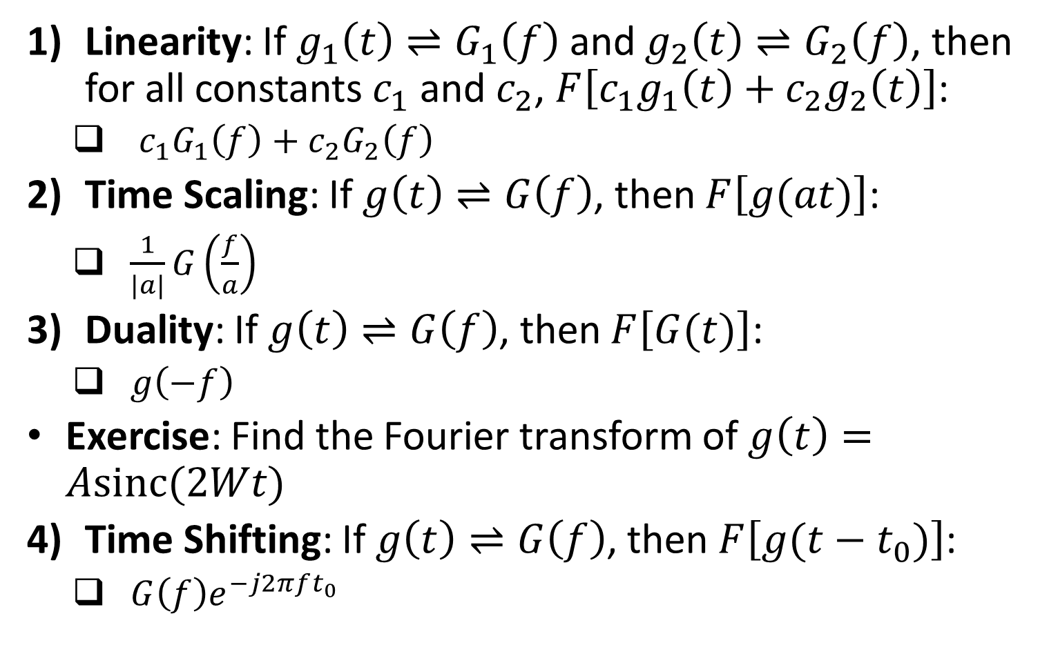
Properties of Fourier Transform
Linearity: If $g_{1}\left(t\right)⇌G_{1}\left(f\right)$ and $g_{2}\left(t\right)⇌G_{2}\left(f\right)$, then for all constants $c_{1}$ and $c_{2}$, $F\left[c_{1}g_{1}\left(t\right)+c_{2}g_{2}\left(t\right)\right]$:
$c_{1}G_{1}\left(f\right)+c_{2}G_{2}\left(f\right)$
Time Scaling: If $g\left(t\right)⇌G\left(f\right)$, then $F\left[g(at)\right]$:
$\frac{1}{|a|}G\left(\frac{f}{a}\right)$
Duality: If $g\left(t\right)⇌G\left(f\right)$, then $F\left[G(t)\right]$:
$g\left(−f\right)$
Exercise: Find the Fourier transform of $g\left(t\right)=Asinc(2Wt)$
Time Shifting: If $g\left(t\right)⇌G\left(f\right)$, then $F\left[g(t−t_{0})\right]$:
$G\left(f\right)e^{−j2πft_{0}}$

Slide 7
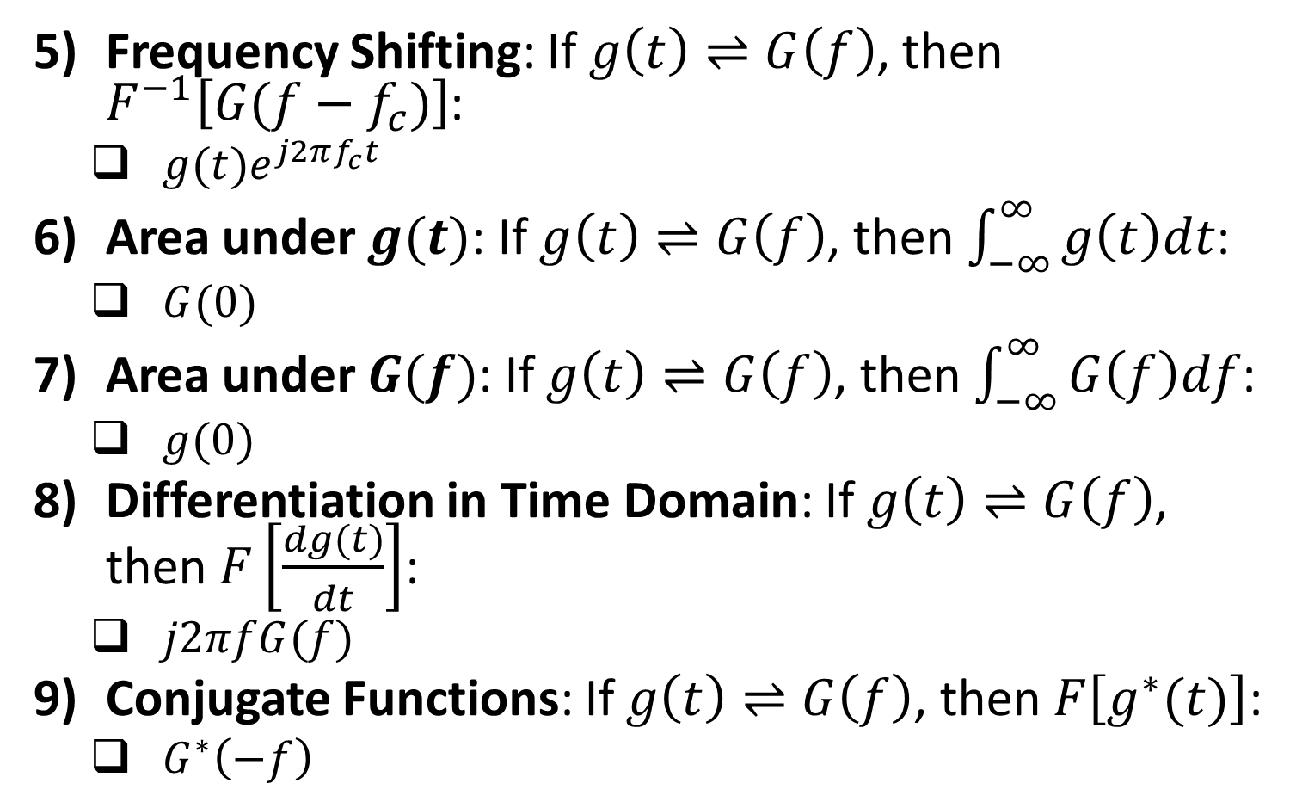
Properties of Fourier Transform (contd.)
Frequency Shifting: If $g\left(t\right)⇌G\left(f\right)$, then $F^{−1}\left[G(f−f_{c})\right]$:
$g(t)e^{j2πf_{c}t}$
Area under $g(t)$: If $g\left(t\right)⇌G\left(f\right)$, then $\int_{−∞}^{∞}{g\left(t\right)dt}$:
$G(0)$
Area under $G(f)$: If $g\left(t\right)⇌G\left(f\right)$, then $\int_{−∞}^{∞}{G\left(f\right)df}$:
$g(0)$
Differentiation in Time Domain: If $g\left(t\right)⇌G\left(f\right)$, then $F\left[\frac{dg(t)}{dt}\right]$:
$j2πfG(f)$
Conjugate Functions: If $g\left(t\right)⇌G\left(f\right)$, then $F\left[g^{∗}(t)\right]$:
$G^{∗}\left(−f\right)$

Slide 8
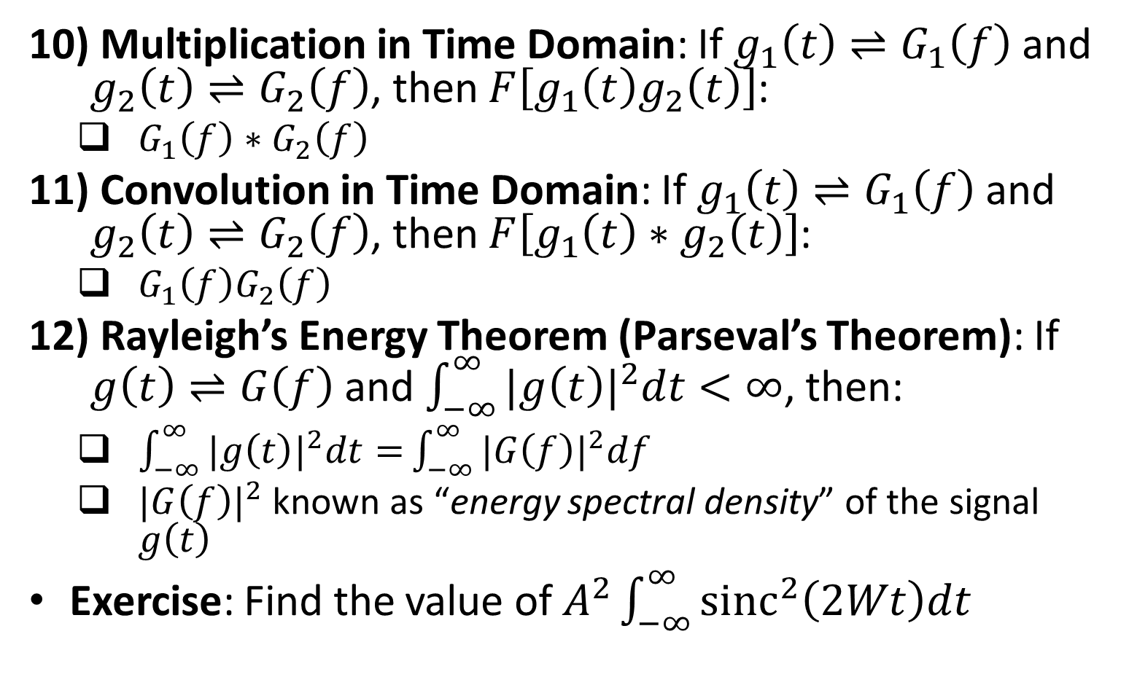
Properties of Fourier Transform (contd.)
Multiplication in Time Domain: If $g_{1}\left(t\right)⇌G_{1}\left(f\right)$ and $g_{2}\left(t\right)⇌G_{2}\left(f\right)$, then $F\left[g_{1}\left(t\right)g_{2}\left(t\right)\right]$:
$G_{1}\left(f\right)∗G_{2}\left(f\right)$
Convolution in Time Domain: If $g_{1}\left(t\right)⇌G_{1}\left(f\right)$ and $g_{2}\left(t\right)⇌G_{2}\left(f\right)$, then $F\left[g_{1}\left(t\right)∗g_{2}\left(t\right)\right]$:
$G_{1}\left(f\right)G_{2}\left(f\right)$
Rayleigh’s Energy Theorem (Parseval’s Theorem): If $g\left(t\right)⇌G\left(f\right)$ and $\int_{−∞}^{∞}{{|g\left(t\right)|}^{2}dt<∞}$, then:
$\int_{−∞}^{∞}{{|g\left(t\right)|}^{2}dt=}\int_{−∞}^{∞}{{|G\left(f\right)|}^{2}df}$
${|G\left(f\right)|}^{2}$ known as “energy spectral density” of the signal $g\left(t\right)$
Exercise: Find the value of $A^{2}\int_{−∞}^{∞}{{sinc}^{2}\left(2Wt\right)dt}$

Slide 9
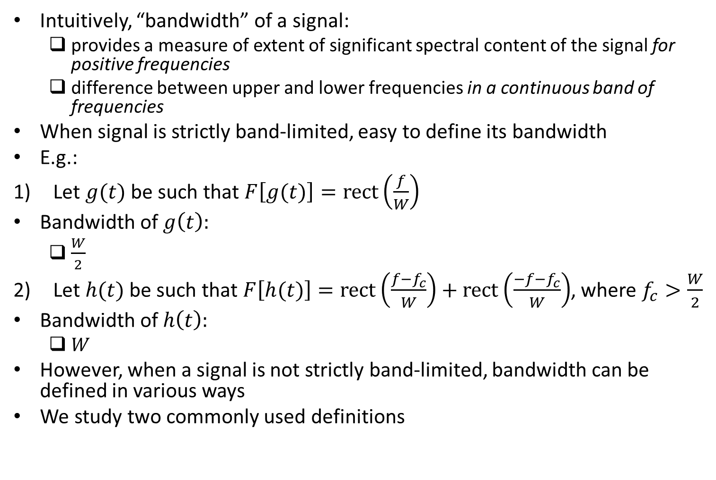
Bandwidth
Intuitively, “bandwidth” of a signal:
provides a measure of extent of significant spectral content of the signal for positive frequencies
difference between upper and lower frequencies in a continuous band of frequencies
When signal is strictly band-limited, easy to define its bandwidth
E.g.:
Let $g(t)$ be such that $F\left[g(t)\right]=rect\left(\frac{f}{W}\right)$
Bandwidth of $g\left(t\right):$
$\frac{W}{2}$
Let $h(t)$ be such that $F\left[h(t)\right]=rect\left(\frac{f−f_{c}}{W}\right)+rect\left(\frac{−f−f_{c}}{W}\right)$, where $f_{c}>\frac{W}{2}$
Bandwidth of $h\left(t\right):$
$W$
However, when a signal is not strictly band-limited, bandwidth can be defined in various ways
We study two commonly used definitions

Slide 10
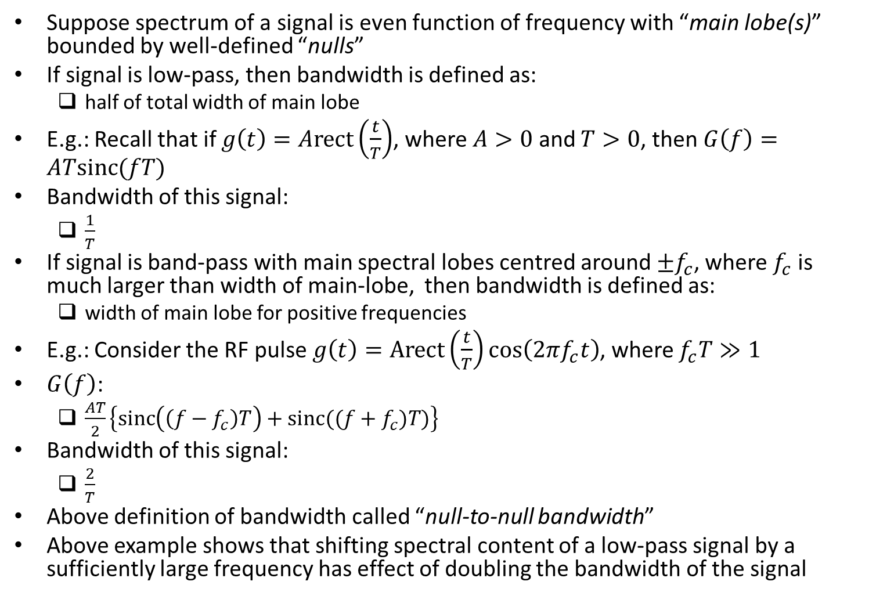
Null-to-null Bandwidth
Suppose spectrum of a signal is even function of frequency with “main lobe(s)” bounded by well-defined “nulls”
If signal is low-pass, then bandwidth is defined as:
half of total width of main lobe
E.g.: Recall that if $g\left(t\right)=Arect\left(\frac{t}{T}\right)$, where $A>0$ and $T>0$, then $G\left(f\right)=ATsinc(fT)$
Bandwidth of this signal:
$\frac{1}{T}$
If signal is band-pass with main spectral lobes centred around $±f_{c}$, where $f_{c}$ is much larger than width of main-lobe, then bandwidth is defined as:
width of main lobe for positive frequencies
E.g.: Consider the RF pulse $g\left(t\right)=Arect\left(\frac{t}{T}\right)cos⁡\left(2πf_{c}t\right)$, where $f_{c}T≫1$
$G\left(f\right)$:
$\frac{AT}{2}\left\{sinc\left(\left(f−f_{c}\right)T\right)+sinc((f+f_{c})T)\right\}$
Bandwidth of this signal:
$\frac{2}{T}$
Above definition of bandwidth called “null-to-null bandwidth”
Above example shows that shifting spectral content of a low-pass signal by a sufficiently large frequency has effect of doubling the bandwidth of the signal

Slide 11
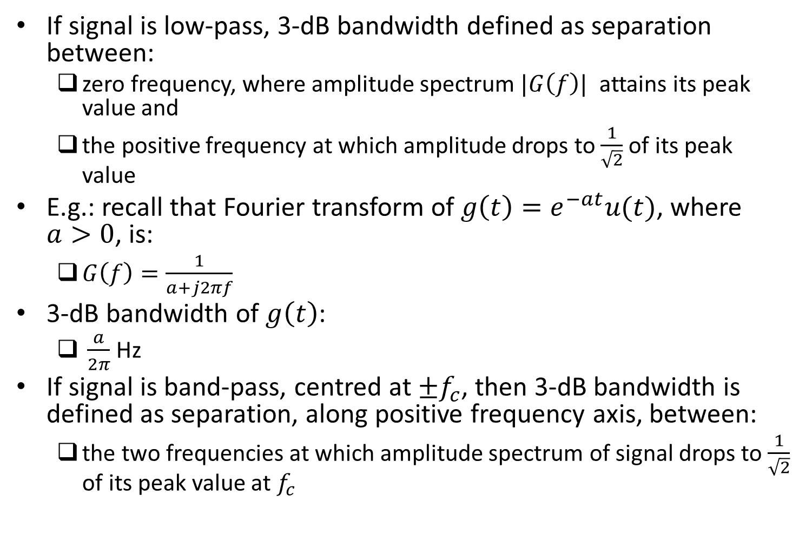
3-dB Bandwidth
If signal is low-pass, 3-dB bandwidth defined as separation between:
zero frequency, where amplitude spectrum $|G\left(f\right)|$ attains its peak value and
the positive frequency at which amplitude drops to $\frac{1}{\sqrt{2}}$ of its peak value
E.g.: recall that Fourier transform of $g\left(t\right)=e^{−at}u(t)$, where $a>0$, is:
$G\left(f\right)=\frac{1}{a+j2πf}$
3-dB bandwidth of $g\left(t\right)$:
$\frac{a}{2π}$ Hz
If signal is band-pass, centred at $±f_{c}$, then 3-dB bandwidth is defined as separation, along positive frequency axis, between:
the two frequencies at which amplitude spectrum of signal drops to $\frac{1}{\sqrt{2}}$ of its peak value at $f_{c}$

Slide 12
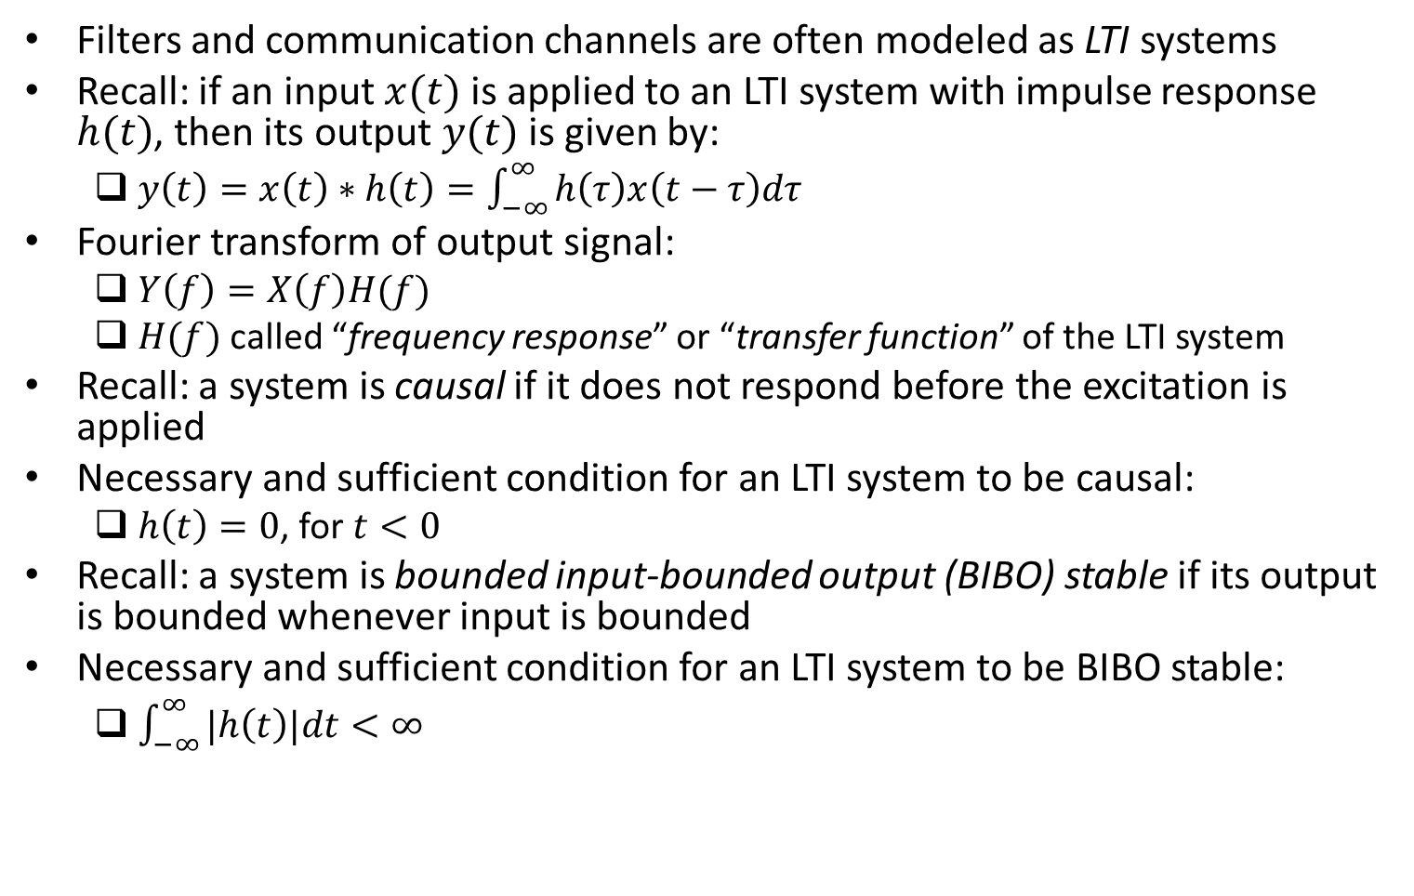
Transmission of Signals Through Linear Time-Invariant (LTI) Systems
Filters and communication channels are often modeled as LTI systems
Recall: if an input $x(t)$ is applied to an LTI system with impulse response $h(t)$, then its output $y(t)$ is given by:
$y\left(t\right)=x\left(t\right)∗h\left(t\right)=\int_{−∞}^{∞}{h\left(τ\right)x\left(t−τ\right)dτ}$
Fourier transform of output signal:
$Y\left(f\right)=X\left(f\right)H(f)$
$H(f)$ called “frequency response” or “transfer function” of the LTI system
Recall: a system is causal if it does not respond before the excitation is applied
Necessary and sufficient condition for an LTI system to be causal:
$h\left(t\right)=0$, for $t<0$
Recall: a system is bounded input-bounded output (BIBO) stable if its output is bounded whenever input is bounded
Necessary and sufficient condition for an LTI system to be BIBO stable:
$\int_{−∞}^{∞}{|h\left(t\right)|dt<∞}$

Slide 13
Filter
A frequency-selective device
Common use in communications:
To limit the spectrum of a signal to some specified band of frequencies
Frequency response of a filter has a “passband” and a “stopband”
Frequencies of input inside passband are output with little or no distortion
Frequencies of input inside stopband are blocked or significantly attenuated
Common types of filters:
low-pass, band-pass, high-pass, band-stop

Slide 14
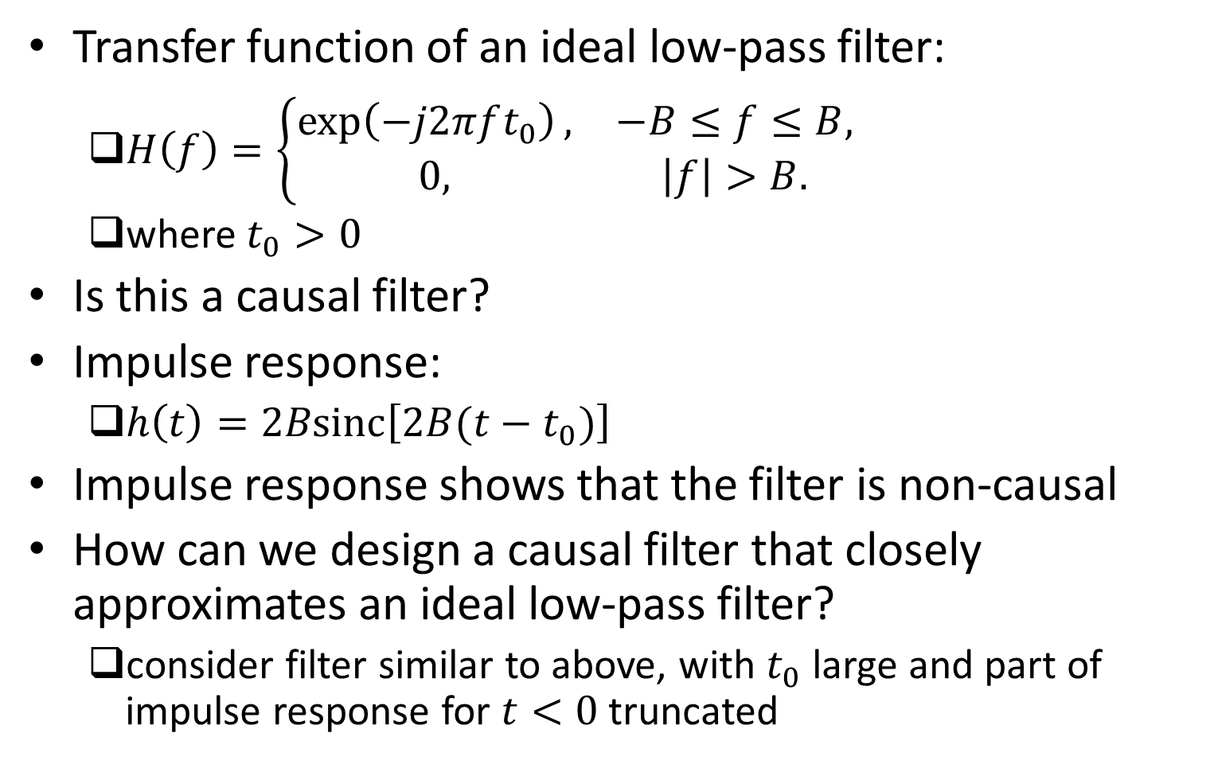
Example
Transfer function of an ideal low-pass filter:
$H\left(f\right)=\left\{\begin{matrix}\exp\left(−j2πft_{0}\right), & −B≤f≤B, \\ 0, & \left|f\right|>B.\end{matrix}\right.$
where $t_{0}>0$
Is this a causal filter?
Impulse response:
$h\left(t\right)=2Bsinc\left[2B(t−t_{0})\right]$
Impulse response shows that the filter is non-causal
How can we design a causal filter that closely approximates an ideal low-pass filter?
consider filter similar to above, with $t_{0}$ large and part of impulse response for $t<0$ truncated

Slide 15
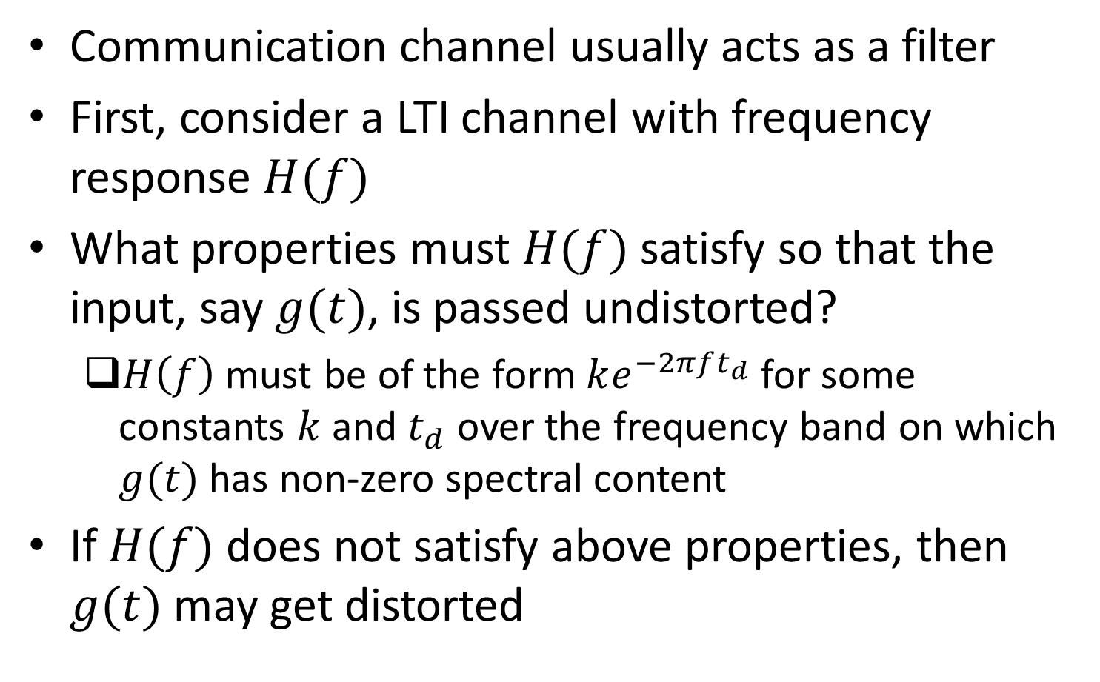
Communication Link Viewed as a Filter: LTI Channel
Communication channel usually acts as a filter
First, consider a LTI channel with frequency response $H(f)$
What properties must $H(f)$ satisfy so that the input, say $g(t)$, is passed undistorted?
$H\left(f\right)$ must be of the form $ke^{−2πft_{d}}$ for some constants $k$ and $t_{d}$ over the frequency band on which $g(t)$ has non-zero spectral content
If $H(f)$ does not satisfy above properties, then $g(t)$ may get distorted

Slide 16
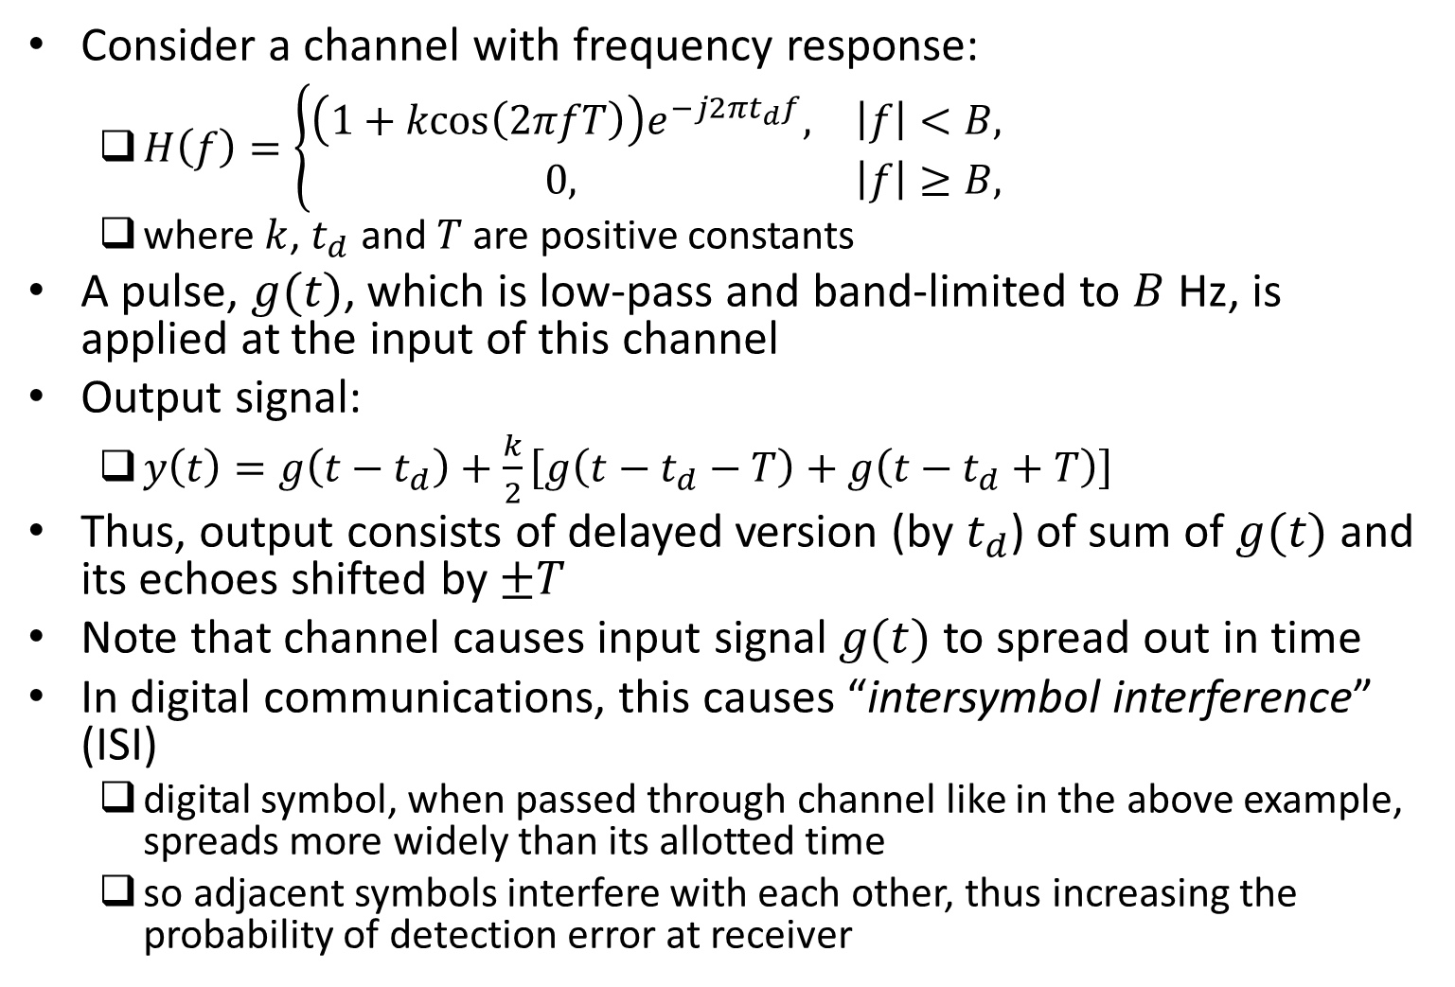
Example
Consider a channel with frequency response:
$H\left(f\right)=\left\{\begin{matrix}\left(1+kcos\left(2πfT\right)\right)e^{−j2πt_{d}f}, & \left|f\right|<B, \\ 0, & \left|f\right|≥B,\end{matrix}\right.$
where $k$, $t_{d}$ and $T$ are positive constants
A pulse, $g(t)$, which is low-pass and band-limited to $B$ Hz, is applied at the input of this channel
Output signal:
$y\left(t\right)=g\left(t−t_{d}\right)+\frac{k}{2}\left[g\left(t−t_{d}−T\right)+g\left(t−t_{d}+T\right)\right]$
Thus, output consists of delayed version (by $t_{d}$) of sum of $g(t)$ and its echoes shifted by $±T$
Note that channel causes input signal $g(t)$ to spread out in time
In digital communications, this causes “intersymbol interference” (ISI)
digital symbol, when passed through channel like in the above example, spreads more widely than its allotted time
so adjacent symbols interfere with each other, thus increasing the probability of detection error at receiver

Slide 17
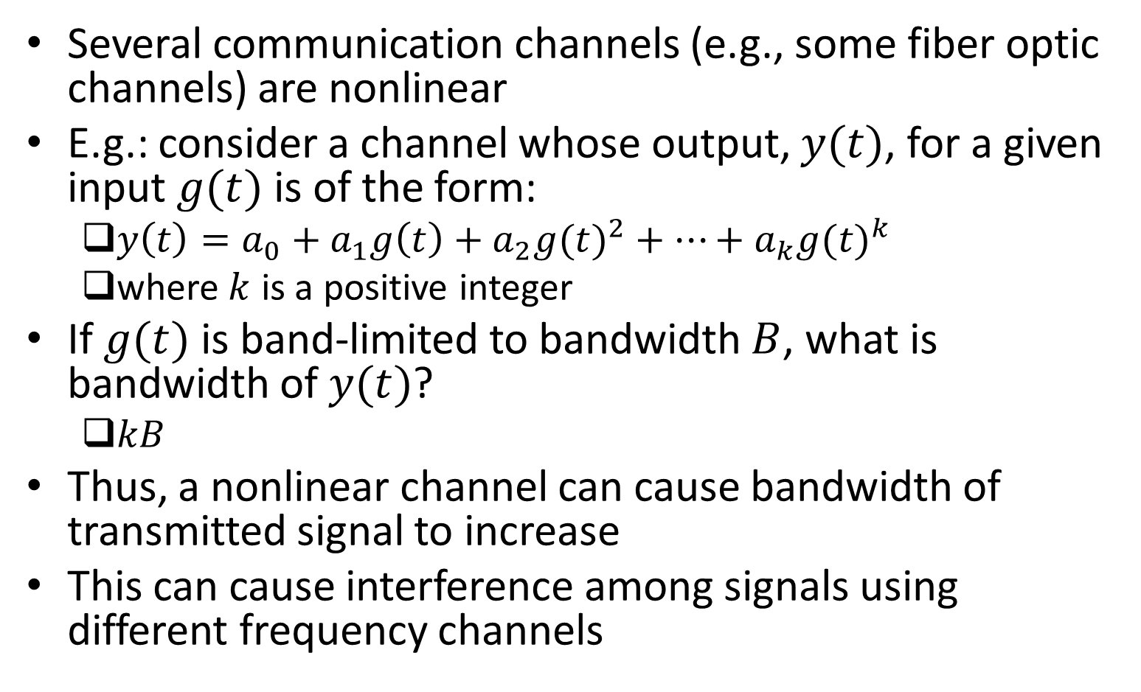
Communication Link Viewed as a Filter: Nonlinear Channel
Several communication channels (e.g., some fiber optic channels) are nonlinear
E.g.: consider a channel whose output, $y(t)$, for a given input $g(t)$ is of the form:
$y\left(t\right)=a_{0}+a_{1}g\left(t\right)+a_{2}{g(t)}^{2}+…+a_{k}{g(t)}^{k}$
where $k$ is a positive integer
If $g(t)$ is band-limited to bandwidth $B$, what is bandwidth of $y(t)$?
$kB$
Thus, a nonlinear channel can cause bandwidth of transmitted signal to increase
This can cause interference among signals using different frequency channels

Slide 18
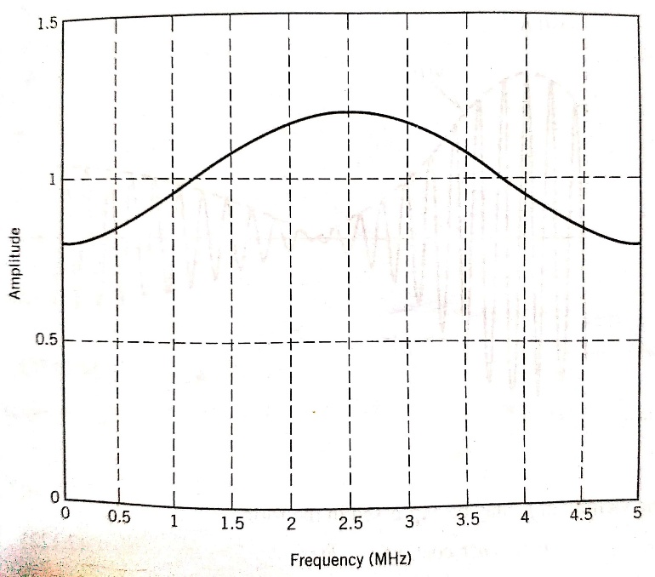
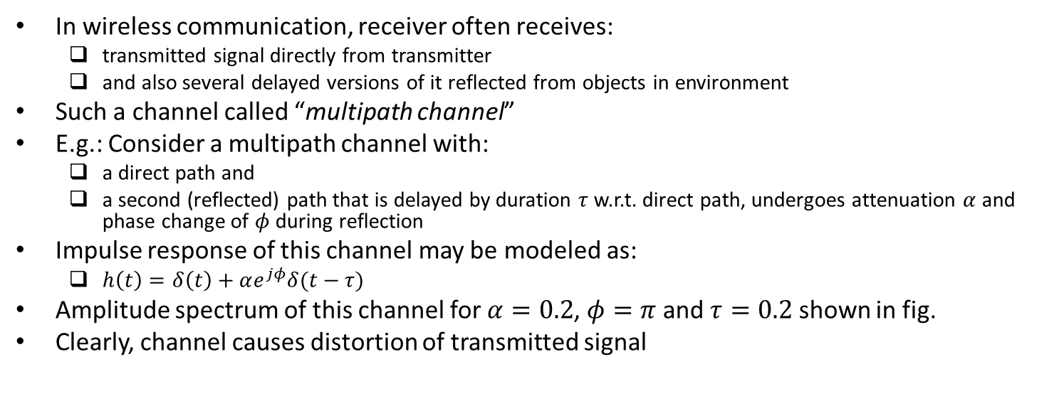
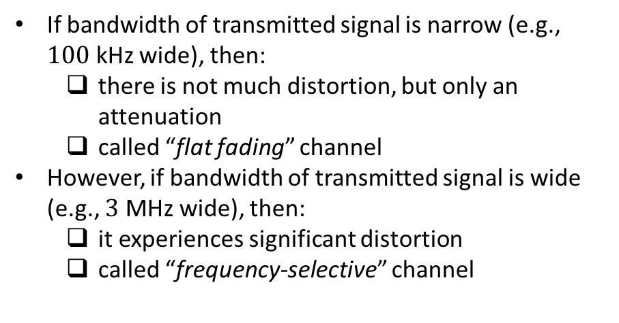
Communication Link Viewed as a Filter: Multipath Channel
In wireless communication, receiver often receives:
transmitted signal directly from transmitter
and also several delayed versions of it reflected from objects in environment
Such a channel called “multipath channel”
E.g.: Consider a multipath channel with:
a direct path and
a second (reflected) path that is delayed by duration $τ$ w.r.t. direct path, undergoes attenuation $α$ and phase change of $φ$ during reflection
Impulse response of this channel may be modeled as:
$h\left(t\right)=δ\left(t\right)+αe^{jφ}δ(t−τ)$
Amplitude spectrum of this channel for $α=0.2$, $φ=π$ and $τ=0.2$ shown in fig.
Clearly, channel causes distortion of transmitted signal
If bandwidth of transmitted signal is narrow (e.g., $100$ kHz wide), then:
there is not much distortion, but only an attenuation
called “flat fading” channel
However, if bandwidth of transmitted signal is wide (e.g., $3$ MHz wide), then:
it experiences significant distortion
called “frequency-selective” channel
Ref: “Communication Systems” by S. Haykin and M. Moher, 5th ed

Slide 19
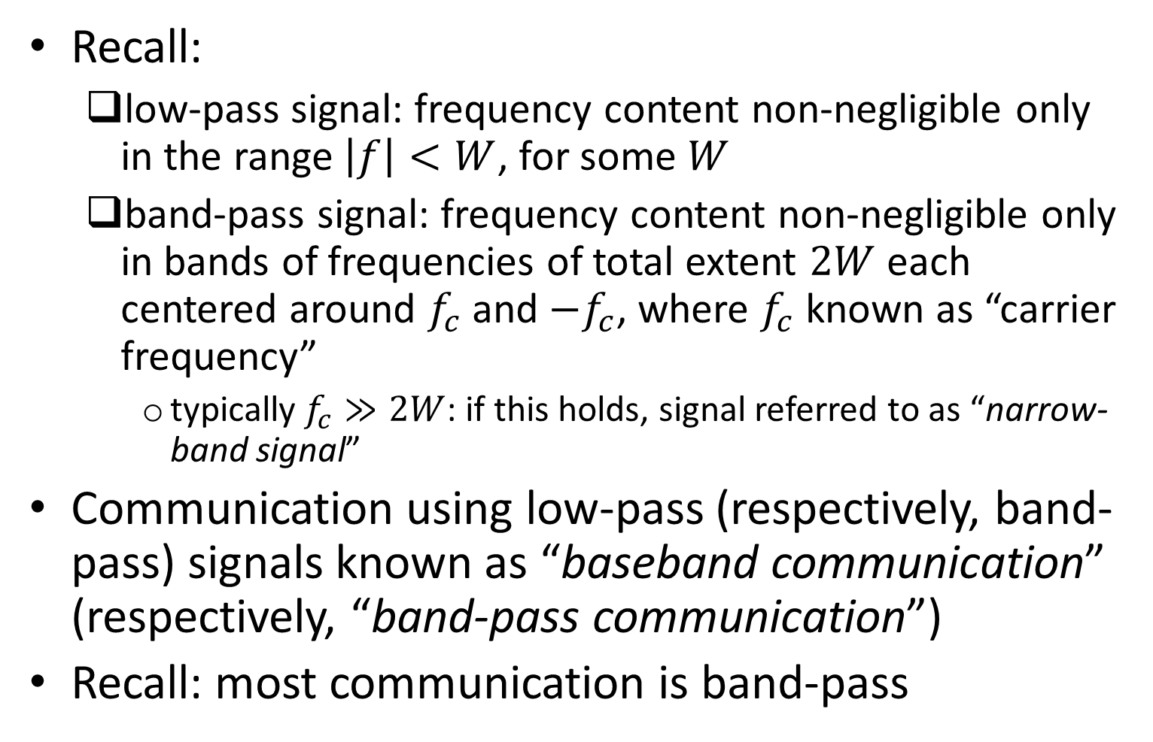
Terminology: Low-pass and Band-pass Communication
Recall:
low-pass signal: frequency content non-negligible only in the range $\left|f\right|<W$, for some $W$
band-pass signal: frequency content non-negligible only in bands of frequencies of total extent $2W$ each centered around $f_{c}$ and ${−f}_{c}$, where $f_{c}$ known as “carrier frequency”
typically $f_{c}≫2W$: if this holds, signal referred to as “narrow-band signal”
Communication using low-pass (respectively, band-pass) signals known as “baseband communication” (respectively, “band-pass communication”)
Recall: most communication is band-pass

Slide 20
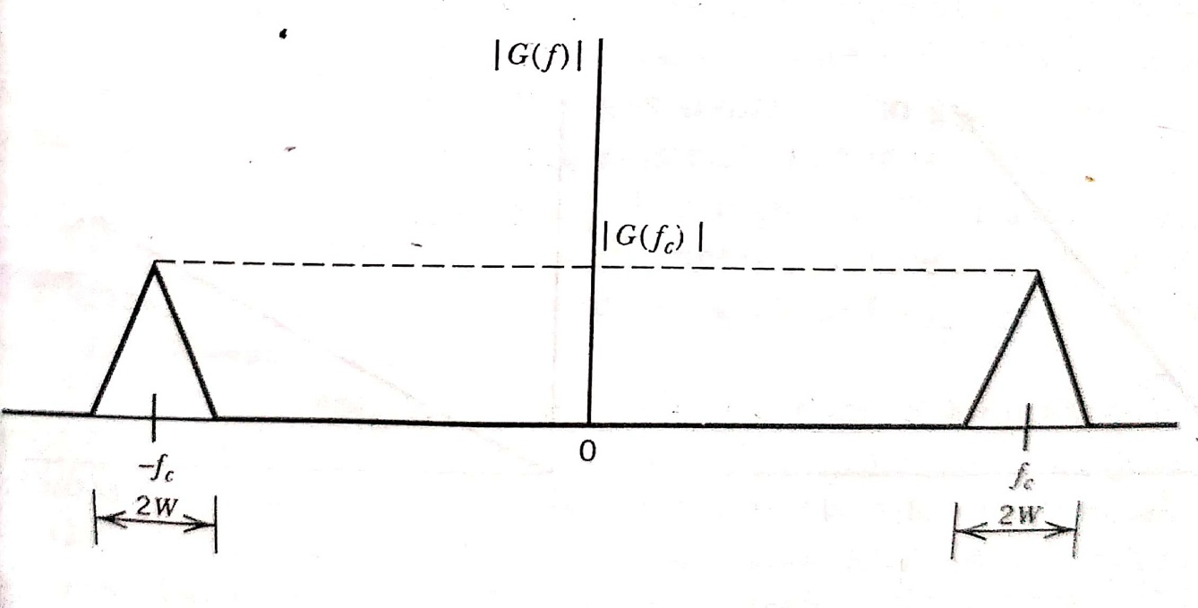
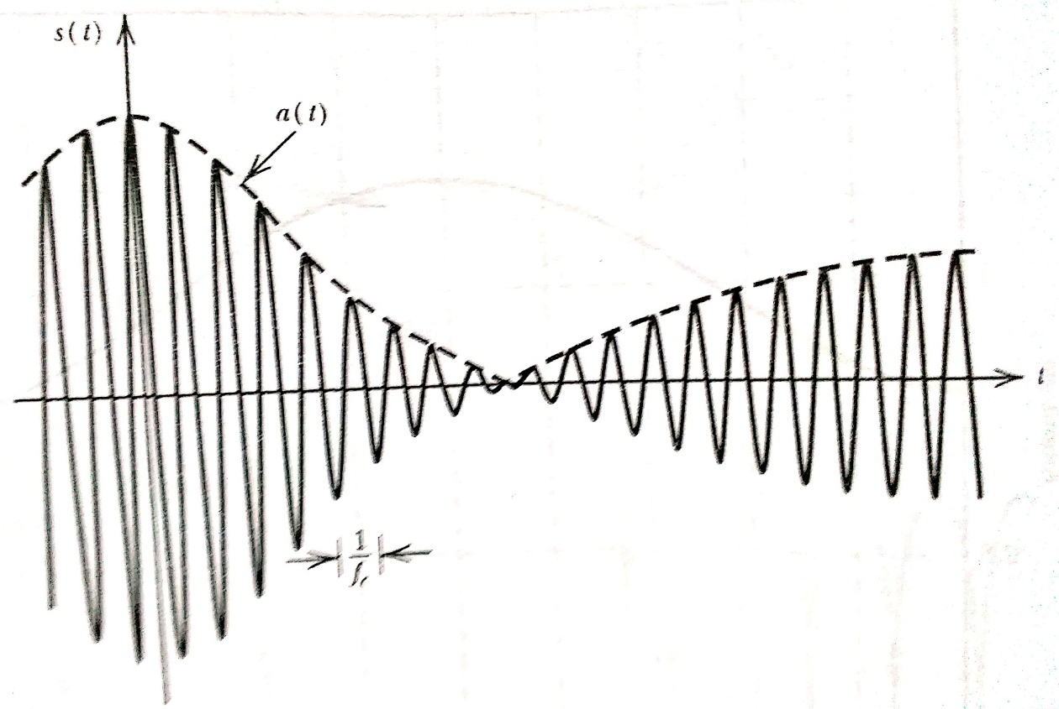
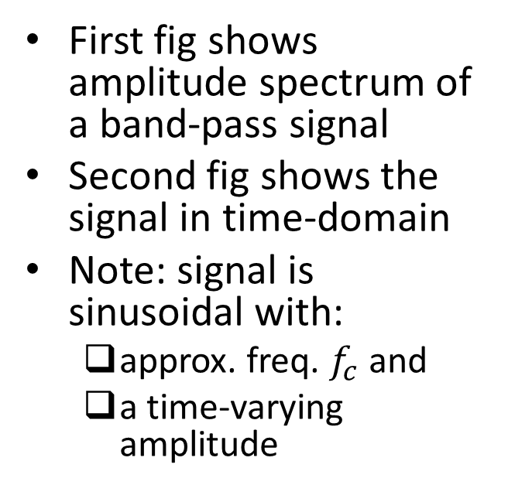
Example
First fig shows amplitude spectrum of a band-pass signal
Second fig shows the signal in time-domain
Note: signal is sinusoidal with:
approx. freq. $f_{c}$ and
a time-varying amplitude
Ref: “Communication Systems” by S. Haykin and M. Moher, 5th ed

Slide 21
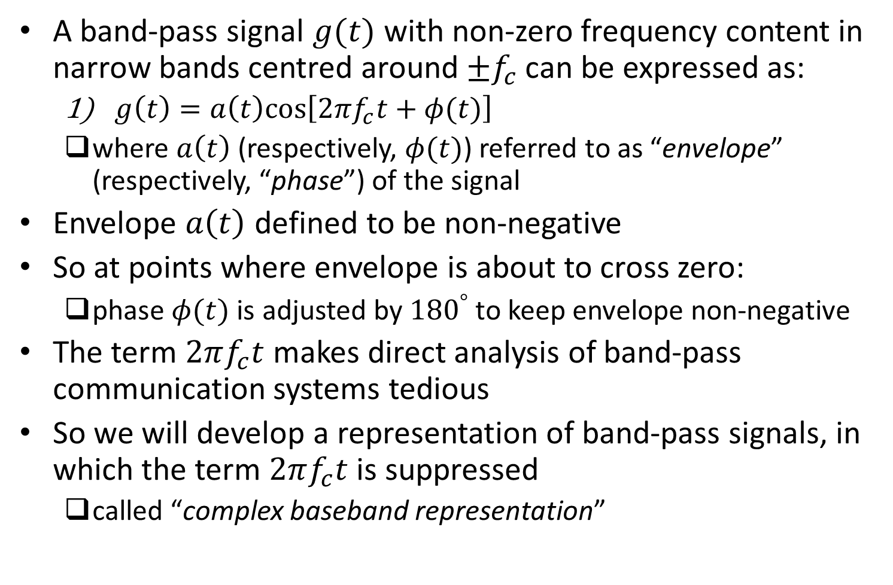
Representation of Band-pass Signals
A band-pass signal $g(t)$ with non-zero frequency content in narrow bands centred around $±f_{c}$ can be expressed as:
$g\left(t\right)=a\left(t\right)cos⁡\left[2πf_{c}t+φ(t)\right]$
where $a\left(t\right)$ (respectively, $φ(t)$) referred to as “envelope” (respectively, “phase”) of the signal
Envelope $a\left(t\right)$ defined to be non-negative
So at points where envelope is about to cross zero:
phase $φ(t)$ is adjusted by ${180}^{°}$ to keep envelope non-negative
The term $2πf_{c}t$ makes direct analysis of band-pass communication systems tedious
So we will develop a representation of band-pass signals, in which the term $2πf_{c}t$ is suppressed
called “complex baseband representation”

Slide 22
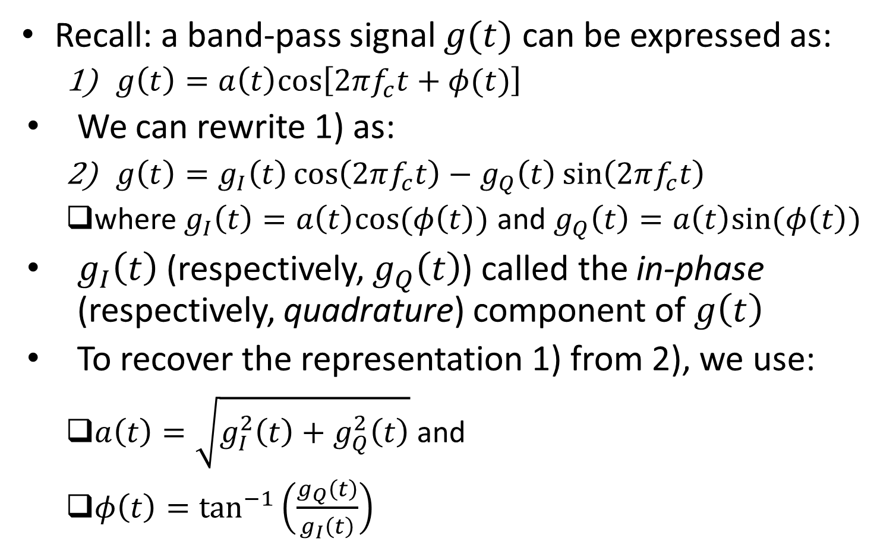
Representation of Band-pass Signals (contd.)
Recall: a band-pass signal $g(t)$ can be expressed as:
$g\left(t\right)=a\left(t\right)cos⁡\left[2πf_{c}t+φ(t)\right]$
We can rewrite 1) as:
$g\left(t\right)=g_{I}\left(t\right)\cos\left(2πf_{c}t\right)−g_{Q}\left(t\right)\sin\left(2πf_{c}t\right)$
where $g_{I}\left(t\right)=a\left(t\right)cos⁡(φ\left(t\right))$ and $g_{Q}\left(t\right)=a\left(t\right)sin⁡(φ\left(t\right))$
$g_{I}\left(t\right)$ (respectively, $g_{Q}\left(t\right)$) called the in-phase (respectively, quadrature) component of $g\left(t\right)$
To recover the representation 1) from 2), we use:
$a\left(t\right)=\sqrt{g_{I}^{2}\left(t\right)+g_{Q}^{2}\left(t\right)}$ and
$φ\left(t\right)=\tan^{−1}\left(\frac{g_{Q}\left(t\right)}{g_{I}\left(t\right)}\right)$

Slide 23
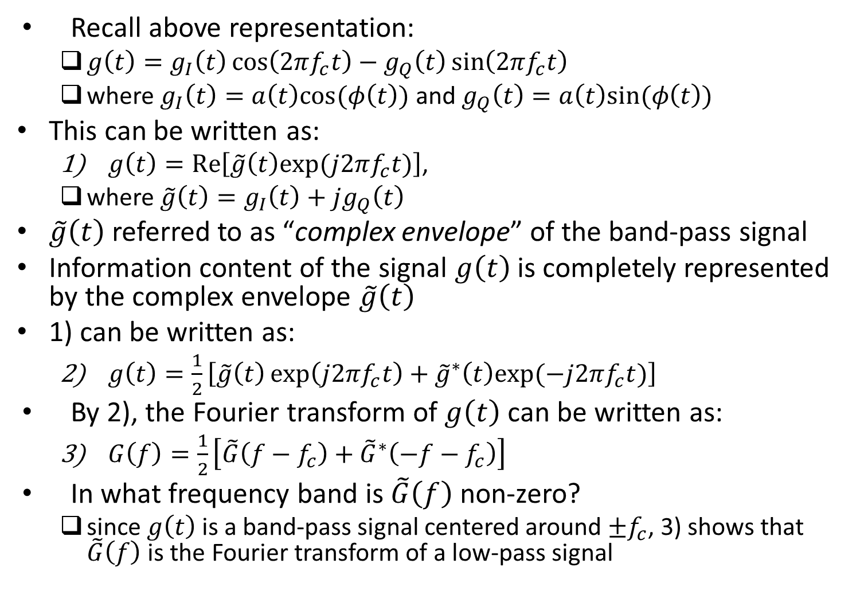
Complex Baseband Representation
Recall above representation:
$g\left(t\right)=g_{I}\left(t\right)\cos\left(2πf_{c}t\right)−g_{Q}\left(t\right)\sin\left(2πf_{c}t\right)$
where $g_{I}\left(t\right)=a\left(t\right)cos⁡(φ\left(t\right))$ and $g_{Q}\left(t\right)=a\left(t\right)sin⁡(φ\left(t\right))$
This can be written as:
$g\left(t\right)=Re\left[\tilde{g}\left(t\right)exp⁡(j2πf_{c}t)\right]$,
where $\tilde{g}\left(t\right)=g_{I}\left(t\right)+jg_{Q}\left(t\right)$
$\tilde{g}\left(t\right)$ referred to as “complex envelope” of the band-pass signal
Information content of the signal $g\left(t\right)$ is completely represented by the complex envelope $\tilde{g}\left(t\right)$
1) can be written as:
$g\left(t\right)=\frac{1}{2}\left[\tilde{g}\left(t\right)\exp\left(j2πf_{c}t\right)+{\tilde{g}}^{∗}\left(t\right)exp⁡(−j2πf_{c}t)\right]$
By 2), the Fourier transform of $g\left(t\right)$ can be written as:
$G\left(f\right)=\frac{1}{2}\left[\tilde{G}\left(f−f_{c}\right)+{\tilde{G}}^{∗}\left(−f−f_{c}\right)\right]$
In what frequency band is $\tilde{G}\left(f\right)$ non-zero?
since $g\left(t\right)$ is a band-pass signal centered around $±f_{c}$, 3) shows that $\tilde{G}\left(f\right)$ is the Fourier transform of a low-pass signal

Slide 24
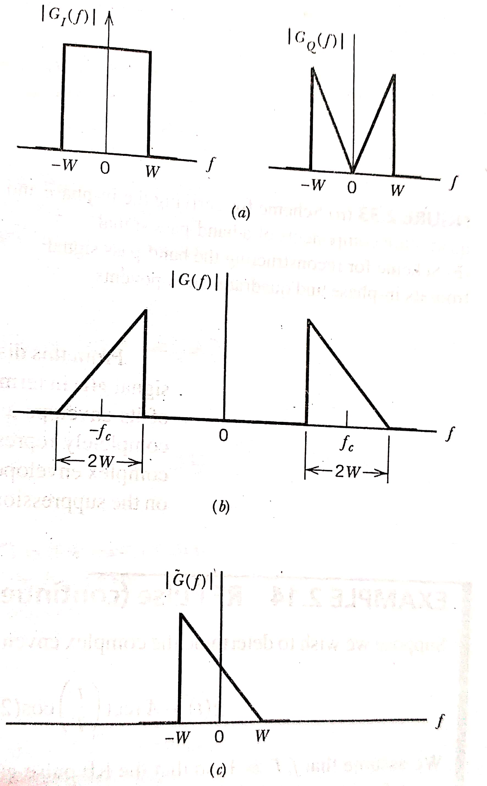
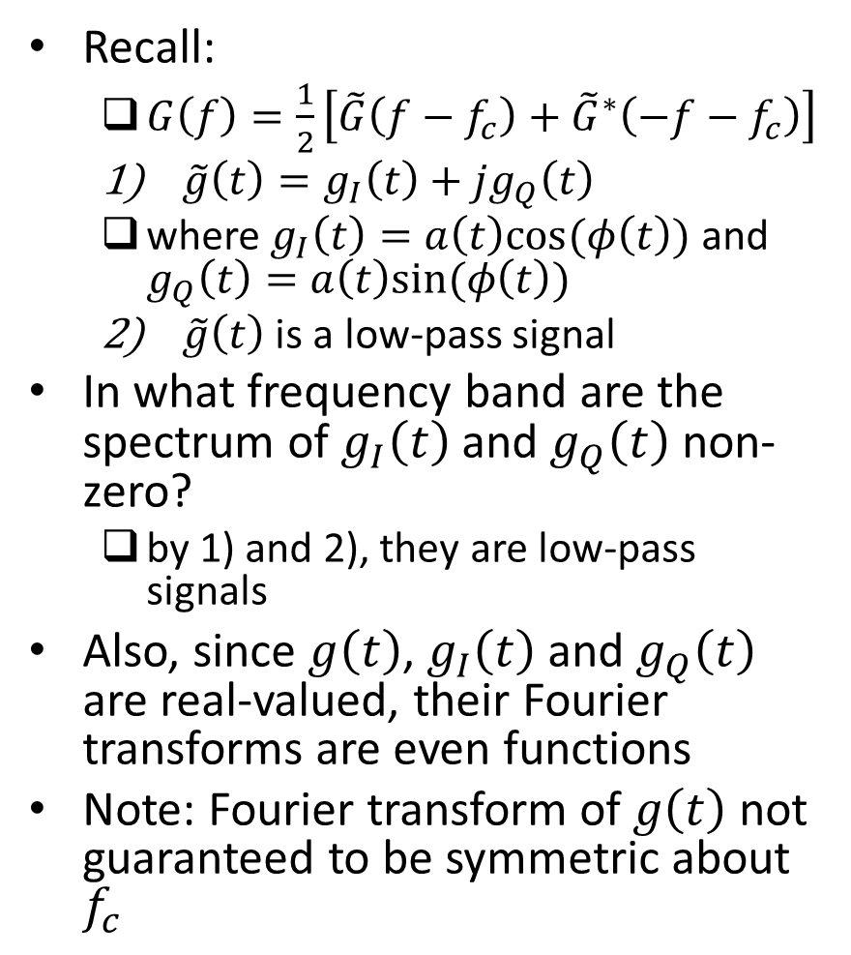
Complex Baseband Representation (contd.)
Recall:
$G\left(f\right)=\frac{1}{2}\left[\tilde{G}\left(f−f_{c}\right)+{\tilde{G}}^{∗}\left(−f−f_{c}\right)\right]$
$\tilde{g}\left(t\right)=g_{I}\left(t\right)+jg_{Q}\left(t\right)$
where $g_{I}\left(t\right)=a\left(t\right)cos⁡(φ\left(t\right))$ and $g_{Q}\left(t\right)=a\left(t\right)sin⁡(φ\left(t\right))$
$\tilde{g}\left(t\right)$ is a low-pass signal
In what frequency band are the spectrum of $g_{I}\left(t\right)$ and $g_{Q}\left(t\right)$ non-zero?
by 1) and 2), they are low-pass signals
Also, since $g\left(t\right)$, $g_{I}\left(t\right)$ and $g_{Q}\left(t\right)$ are real-valued, their Fourier transforms are even functions
Note: Fourier transform of $g\left(t\right)$ not guaranteed to be symmetric about $f_{c}$
Ref: “Communication Systems” by S. Haykin and M. Moher, 5th ed

Slide 25
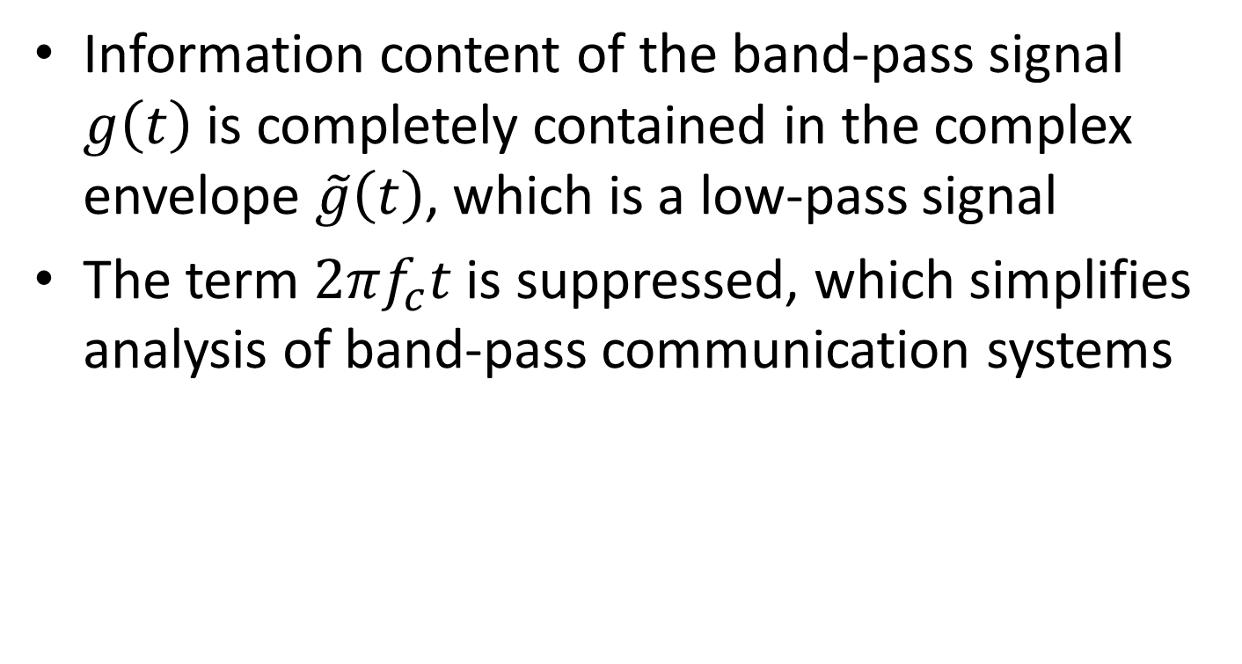
Complex Baseband Representation: Summary
Information content of the band-pass signal $g\left(t\right)$ is completely contained in the complex envelope $\tilde{g}\left(t\right)$, which is a low-pass signal
The term $2πf_{c}t$ is suppressed, which simplifies analysis of band-pass communication systems

Slide 26
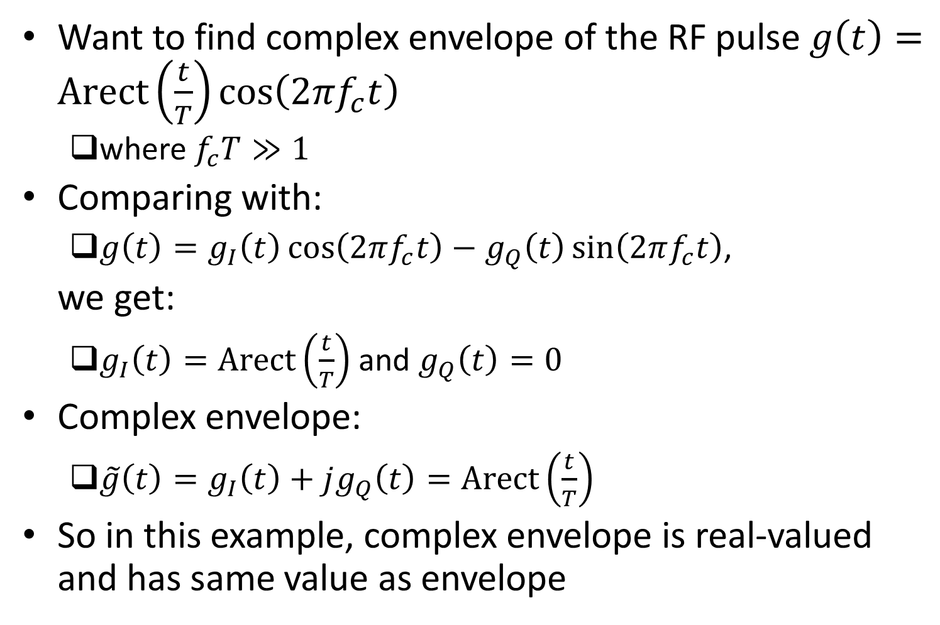
Example
Want to find complex envelope of the RF pulse $g\left(t\right)=Arect\left(\frac{t}{T}\right)cos⁡\left(2πf_{c}t\right)$
where $f_{c}T≫1$
Comparing with:
$g\left(t\right)=g_{I}\left(t\right)\cos\left(2πf_{c}t\right)−g_{Q}\left(t\right)\sin\left(2πf_{c}t\right)$,
we get:
$g_{I}\left(t\right)=Arect\left(\frac{t}{T}\right)$ and $g_{Q}\left(t\right)=0$
Complex envelope:
$\tilde{g}\left(t\right)=g_{I}\left(t\right)+jg_{Q}\left(t\right)=Arect\left(\frac{t}{T}\right)$
So in this example, complex envelope is real-valued and has same value as envelope

Slide 27
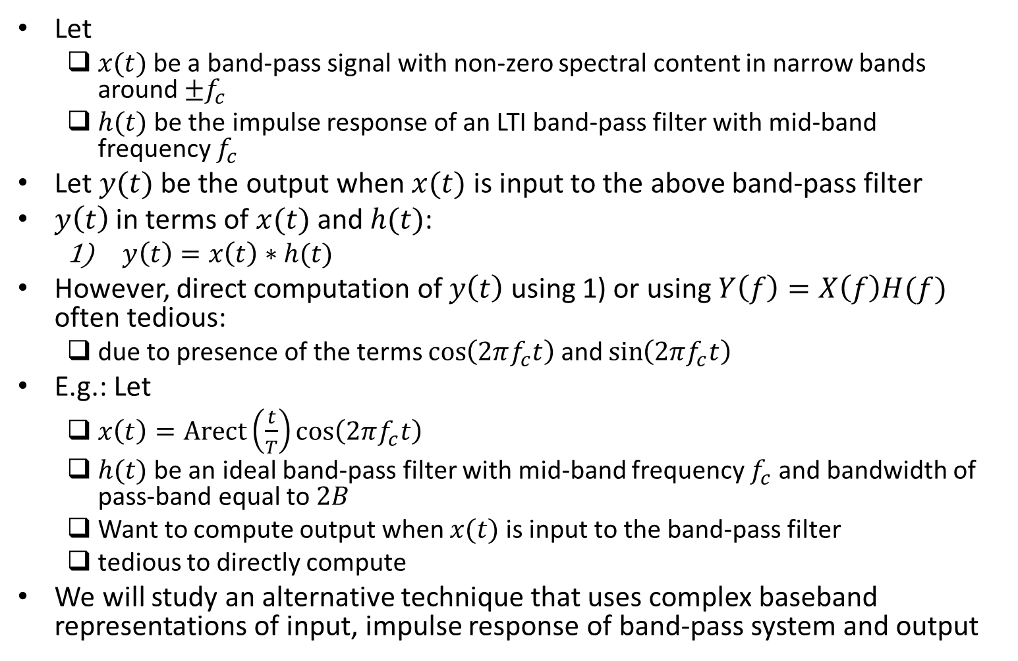
Transmission of Band-pass Signal Through Band-pass Filter
Let
$x(t)$ be a band-pass signal with non-zero spectral content in narrow bands around $±f_{c}$
$h(t)$ be the impulse response of an LTI band-pass filter with mid-band frequency $f_{c}$
Let $y(t)$ be the output when $x(t)$ is input to the above band-pass filter
$y\left(t\right)$ in terms of $x(t)$ and $h(t)$:
$y\left(t\right)=x\left(t\right)∗h(t)$
However, direct computation of $y\left(t\right)$ using 1) or using $Y\left(f\right)=X\left(f\right)H(f)$ often tedious:
due to presence of the terms $\cos\left(2πf_{c}t\right)$ and $\sin\left(2πf_{c}t\right)$
E.g.: Let
$x\left(t\right)=Arect\left(\frac{t}{T}\right)cos⁡\left(2πf_{c}t\right)$
$h(t)$ be an ideal band-pass filter with mid-band frequency $f_{c}$ and bandwidth of pass-band equal to $2B$
Want to compute output when $x(t)$ is input to the band-pass filter
tedious to directly compute
We will study an alternative technique that uses complex baseband representations of input, impulse response of band-pass system and output

Slide 28
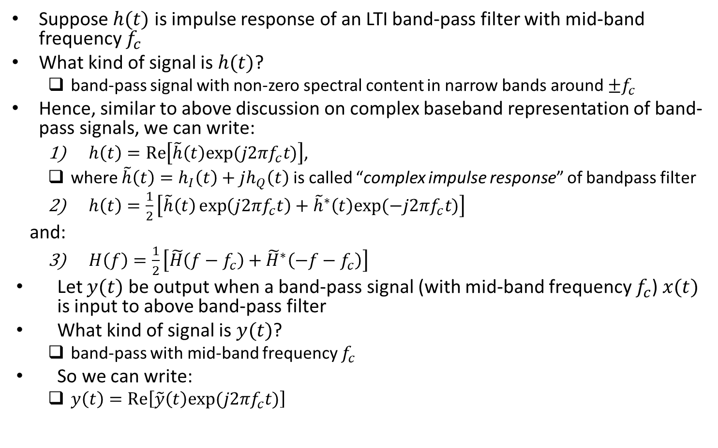
Transmission of Band-pass Signal Through Band-pass Filter (contd.)
Suppose $h(t)$ is impulse response of an LTI band-pass filter with mid-band frequency $f_{c}$
What kind of signal is $h(t)$?
band-pass signal with non-zero spectral content in narrow bands around $±f_{c}$
Hence, similar to above discussion on complex baseband representation of band-pass signals, we can write:
$h\left(t\right)=Re\left[\tilde{h}\left(t\right)exp⁡(j2πf_{c}t)\right]$,
where $\tilde{h}\left(t\right)=h_{I}\left(t\right)+jh_{Q}\left(t\right)$ is called “complex impulse response” of bandpass filter
$h\left(t\right)=\frac{1}{2}\left[\tilde{h}\left(t\right)\exp\left(j2πf_{c}t\right)+{\tilde{h}}^{∗}\left(t\right)exp⁡(−j2πf_{c}t)\right]$
and:
$H\left(f\right)=\frac{1}{2}\left[\tilde{H}\left(f−f_{c}\right)+{\tilde{H}}^{∗}\left(−f−f_{c}\right)\right]$
Let $y(t)$ be output when a band-pass signal (with mid-band frequency $f_{c}$) $x(t)$ is input to above band-pass filter
What kind of signal is $y(t)$?
band-pass with mid-band frequency $f_{c}$
So we can write:
$y\left(t\right)=Re\left[\tilde{y}\left(t\right)exp⁡(j2πf_{c}t)\right]$

Slide 29
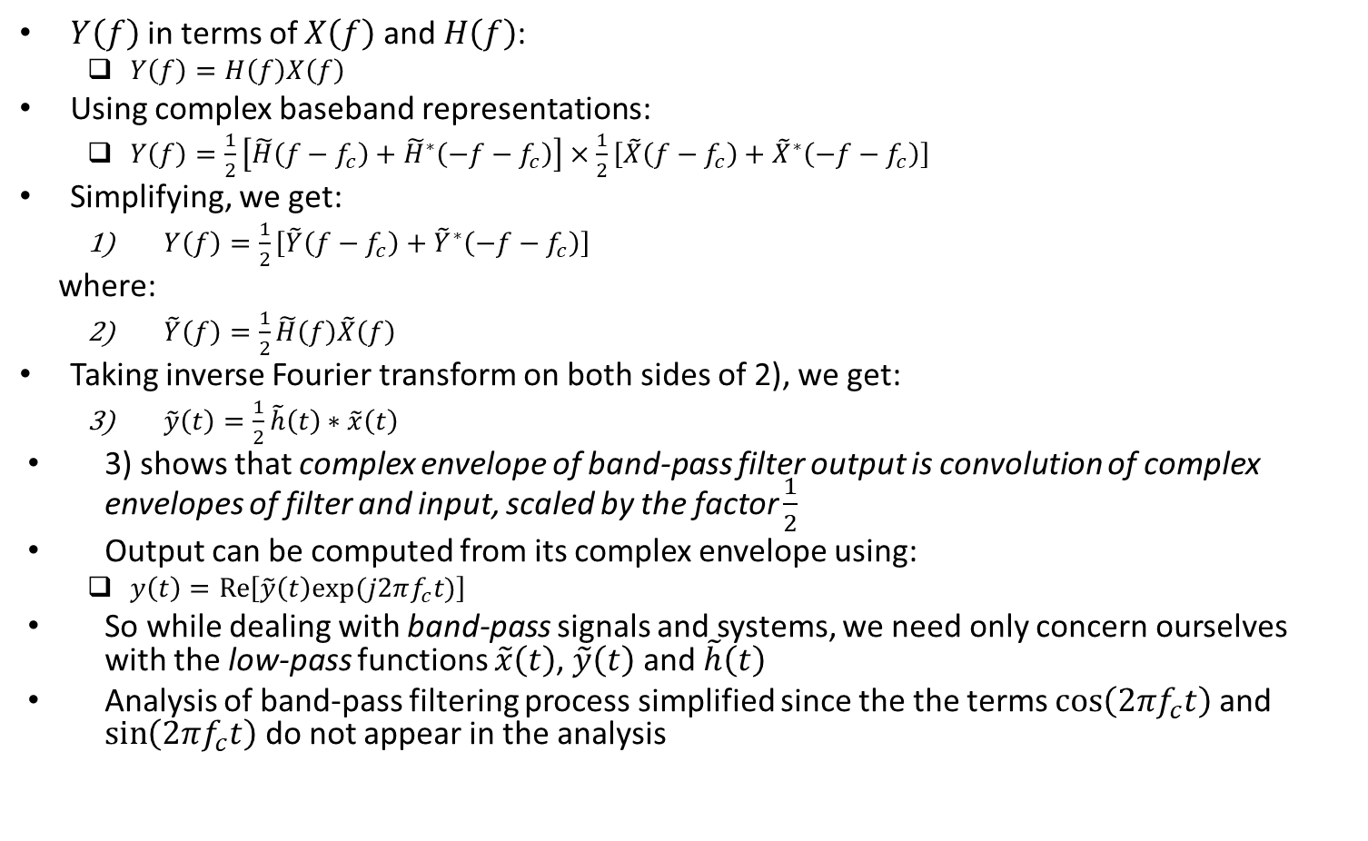
Transmission of Band-pass Signal Through Band-pass Filter (contd.)
$Y\left(f\right)$ in terms of $X\left(f\right)$ and $H\left(f\right)$:
$Y\left(f\right)=H\left(f\right)X\left(f\right)$
Using complex baseband representations:
$Y\left(f\right)=\frac{1}{2}\left[\tilde{H}\left(f−f_{c}\right)+{\tilde{H}}^{∗}\left(−f−f_{c}\right)\right]×\frac{1}{2}\left[\tilde{X}\left(f−f_{c}\right)+{\tilde{X}}^{∗}\left(−f−f_{c}\right)\right]$
Simplifying, we get:
$Y\left(f\right)=\frac{1}{2}\left[\tilde{Y}\left(f−f_{c}\right)+{\tilde{Y}}^{∗}\left(−f−f_{c}\right)\right]$
where:
$\tilde{Y}\left(f\right)=\frac{1}{2}\tilde{H}\left(f\right)\tilde{X}\left(f\right)$
Taking inverse Fourier transform on both sides of 2), we get:
$\tilde{y}\left(t\right)=\frac{1}{2}\tilde{h}\left(t\right)∗\tilde{x}\left(t\right)$
3) shows that complex envelope of band-pass filter output is convolution of complex envelopes of filter and input, scaled by the factor $\frac{1}{2}$
Output can be computed from its complex envelope using:
$y\left(t\right)=Re\left[\tilde{y}\left(t\right)exp⁡(j2πf_{c}t)\right]$
So while dealing with band-pass signals and systems, we need only concern ourselves with the low-pass functions $\tilde{x}\left(t\right)$, $\tilde{y}\left(t\right)$ and $\tilde{h}\left(t\right)$
Analysis of band-pass filtering process simplified since the the terms $\cos\left(2πf_{c}t\right)$ and $\sin\left(2πf_{c}t\right)$ do not appear in the analysis

Slide 30
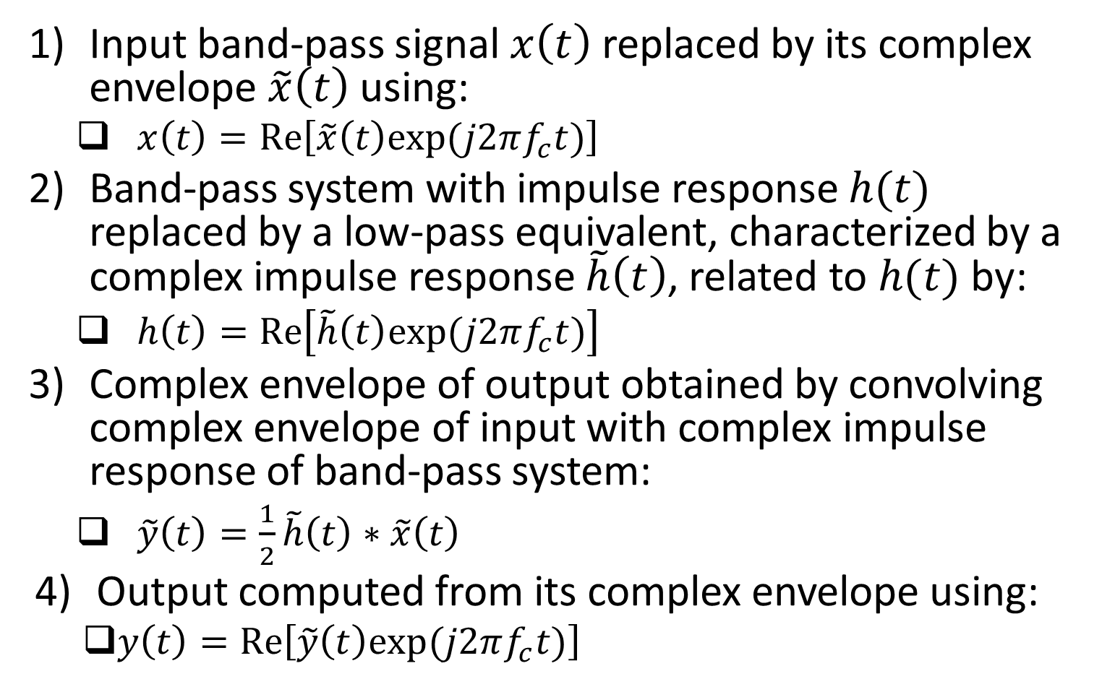
Transmission of Band-pass Signal Through Band-pass Filter: Summary
Input band-pass signal $x\left(t\right)$ replaced by its complex envelope $\tilde{x}\left(t\right)$ using:
$x\left(t\right)=Re\left[\tilde{x}\left(t\right)exp⁡(j2πf_{c}t)\right]$
Band-pass system with impulse response $h(t)$ replaced by a low-pass equivalent, characterized by a complex impulse response $\tilde{h}\left(t\right)$, related to $h(t)$ by:
$h\left(t\right)=Re\left[\tilde{h}\left(t\right)exp⁡(j2πf_{c}t)\right]$
Complex envelope of output obtained by convolving complex envelope of input with complex impulse response of band-pass system:
$\tilde{y}\left(t\right)=\frac{1}{2}\tilde{h}\left(t\right)∗\tilde{x}\left(t\right)$
Output computed from its complex envelope using:
$y\left(t\right)=Re\left[\tilde{y}\left(t\right)exp⁡(j2πf_{c}t)\right]$

Slide 31
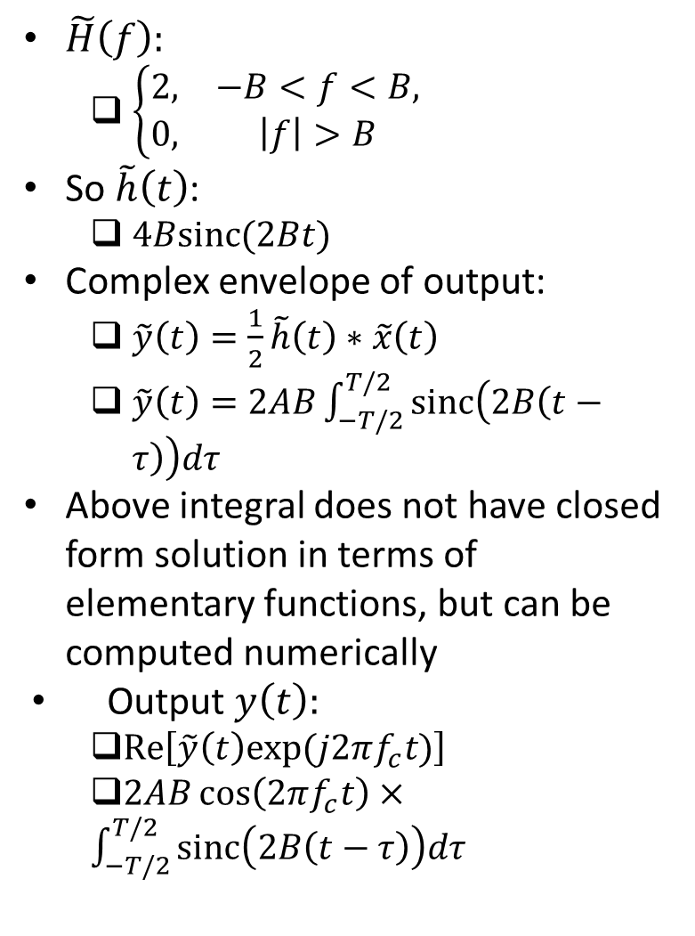
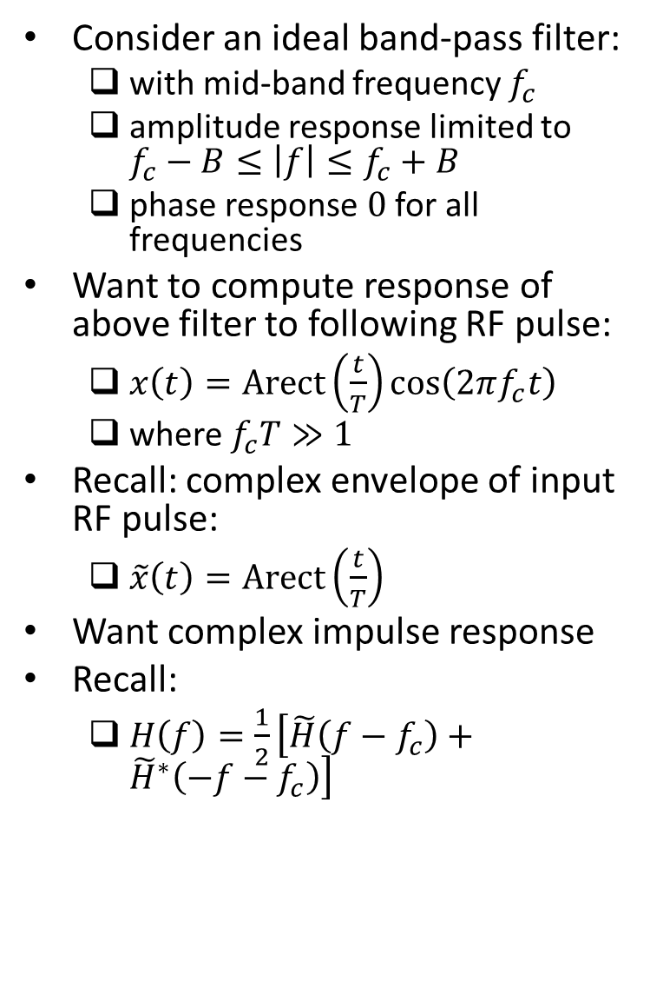
Example
$\tilde{H}\left(f\right):$
$\left\{\begin{matrix}2, & −B<f<B, \\ 0, & \left|f\right|>B\end{matrix}\right.$
So $\tilde{h}\left(t\right)$:
$4Bsinc(2Bt)$
Complex envelope of output:
$\tilde{y}\left(t\right)=\frac{1}{2}\tilde{h}\left(t\right)∗\tilde{x}\left(t\right)$
$\tilde{y}\left(t\right)=2AB\int_{−T/2}^{T/2}{sinc\left(2B\left(t−τ\right)\right)dτ}$
Above integral does not have closed form solution in terms of elementary functions, but can be computed numerically
Output $y\left(t\right):$
$Re\left[\tilde{y}\left(t\right)exp⁡(j2πf_{c}t)\right]$
$2AB\cos\left(2πf_{c}t\right)×\int_{−T/2}^{T/2}{sinc\left(2B\left(t−τ\right)\right)dτ}$
Consider an ideal band-pass filter:
with mid-band frequency $f_{c}$
amplitude response limited to $f_{c}−B≤\left|f\right|≤f_{c}+B$
phase response $0$ for all frequencies
Want to compute response of above filter to following RF pulse:
$x\left(t\right)=Arect\left(\frac{t}{T}\right)cos⁡\left(2πf_{c}t\right)$
where $f_{c}T≫1$
Recall: complex envelope of input RF pulse:
$\tilde{x}\left(t\right)=Arect\left(\frac{t}{T}\right)$
Want complex impulse response
Recall:
$H\left(f\right)=\frac{1}{2}\left[\tilde{H}\left(f−f_{c}\right)+{\tilde{H}}^{∗}\left(−f−f_{c}\right)\right]$

Slide 32
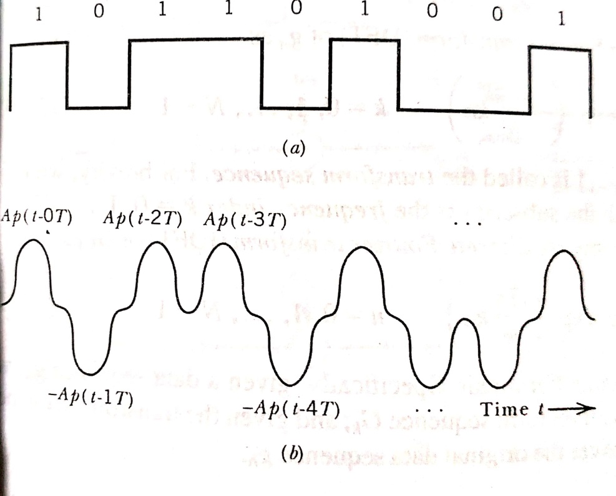
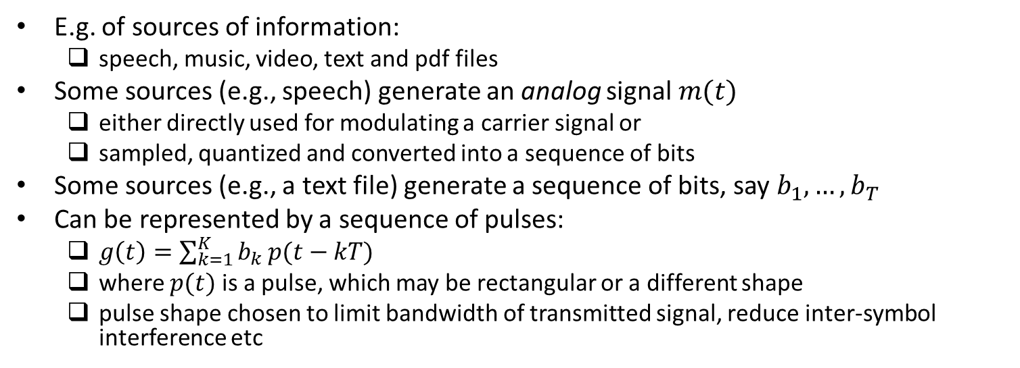
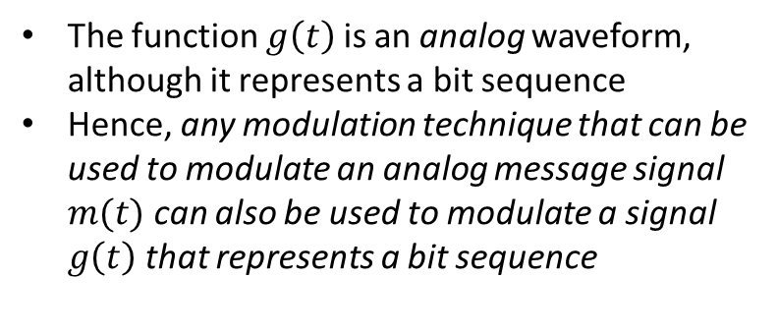
Sources of Information
E.g. of sources of information:
speech, music, video, text and pdf files
Some sources (e.g., speech) generate an analog signal $m(t)$
either directly used for modulating a carrier signal or
sampled, quantized and converted into a sequence of bits
Some sources (e.g., a text file) generate a sequence of bits, say $b_{1}, …,b_{T}$
Can be represented by a sequence of pulses:
$g\left(t\right)=\sum_{k=1}^{K}{b_{k}}p(t−kT)$
where $p(t)$ is a pulse, which may be rectangular or a different shape
pulse shape chosen to limit bandwidth of transmitted signal, reduce inter-symbol interference etc
The function $g\left(t\right)$ is an analog waveform, although it represents a bit sequence
Hence, any modulation technique that can be used to modulate an analog message signal $m(t)$ can also be used to modulate a signal $g\left(t\right)$ that represents a bit sequence
Ref: “Communication Systems” by S. Haykin and M. Moher, 5th ed

